Slide 1
Percutaneous Closure of the Left Atrial Appendage versus Warfarin Therapy for Prevention of Stroke in Patients with Atrial Fibrillation: A Randomized Non-Inferiority Trial
David R. Holmes, MD Vivek Y. Reddy, MD Zoltan G. Turi, MD Shephal K. Doshi, MD Horst Sievert, MD Maurice Buchbinder, MD Christopher M. Mullin Peter Sick, MD For the PROTECT AF Investigators

Slide 2
Non-Valvular Atrial Fibrillation An EPIDEMIC
Affects 1-1.5% of population in developed world
Lifetime risk in men & women >40 is 1 in 4
Prevalence
0.5% age 0-59
9.0% age >80
Currently 2.5 million adults in U.S.
Savelieva: J Intern Med 250, 2001 Go: JAMA 285, 2001
Miyasaka: Circ 114, 2006
3000838-5

Slide 3
Non-Valvular Atrial Fibrillation An EPIDEMIC
Mayo Clinic data (assuming a continued increase in AF incidence)
Mayo Clinic data (assuming further increase in AF incidence)
ATRIA study data (50% >80 yo)
15.9
15.2
14.3
13.1
11.7
10.2
11.7
12.1
Patients with atrial fibrillation (millions)
8.9
11.1
7.7
10.3
9.4
6.7
8.4
5.9
7.5
5.1
6.8
6.1
5.61
5.1
5.6
5.16
5.42
4.34
4.78
3.8
2.94
3.33
2.08
2.26
2.44
2.66
Year
3000838-6

Slide 4
Non-Valvular Atrial Fibrillation
500,000 strokes/year in U.S.
Up to 20% of ischemic strokes occur in patients with atrial fibrillation
Percent of Total Strokes Attributable to Atrial Fibrillation
%
Stroke 22(18), 1991
3000838-7

Slide 5
Non-Valvular Atrial Fibrillation Stroke Prevention Medical Rx
Warfarin cornerstone of therapy
Assuming 51 ischemic strokes/1000 pt-yr
Adjusted standard dose warfarin prevents 28 strokes at expense of 11 fatal bleeds
Aspirin prevents 16 strokes at expense of 6 fatal bleeds
Warfarin
60-70% risk reduction vs no treatment
30-40% risk reduction vs aspirin
Cooper: Arch Int Med 166, 2006 Lip: Thromb Res 118, 2006
3000838-10

Slide 6
Non-Valvular Atrial Fibrillation Stroke Prevention Medical Rx
Warfarin Problematic
Narrow therapeutic window
Multiple drug-drug/drug-food interactions
Genetic variability
Long half-life
PCI issues – triple therapy
Compliance
Contraindications
Bleeding risks
3000838-12

Slide 7
Non-Valvular Atrial Fibrillation Warfarin Use in AF Patients by Age
%
≥
Only 55% of AF patients with no contraindications have evidence of warfarin use in previous 3 months
Other studies cite warfarin use in AF patients from 17-50%
Elderly patients with increased absolute risk least likely to be taking warfarin
Contraindications 30-40%
Ann Int Med 131(12), 1999
3000838-13

Slide 8
Non-Valvular Atrial Fibrillation Adequacy of Anticoagulation in Clinic
Low INR <1.6
Efficacy ↓ 4-fold
Therapeutic INR 2-3
High INR >3.2
%
Bungard: Pharmacotherapy 20:1060, 2001
3000838-14

Slide 9
Non-Valvular Atrial Fibrillation Stroke Pathology
Major fatal bleed with age >75 = 3%/year (30% over 10 years)
Intracranial hemorrhage
0.3-0.5%/100 patient-years
3% in INR >4.0
10% if INR >4.5
Brass. Stroke 28(12), 1997 VanWalraven: JAMA 288, 2002
3000838-15

Slide 10
Non-Valvular Atrial Fibrillation Stroke Pathology
Insufficient contraction of LAA leads to stagnant blood flow
Most likely culprit: embolization of LAA clot
90% of thrombus found in LAA
TEE-based risk factors
Enlarged LAA
Reduced inflow and outflow velocities
Spontaneous Echo contrast
Blackshear: Ann Thoracic Surg 61, 1996 Johnson: Eur J Cardiothoracic Surg 17, 2000 Fagan: Echocardiography 17, 2000
3000838-9

Slide 11
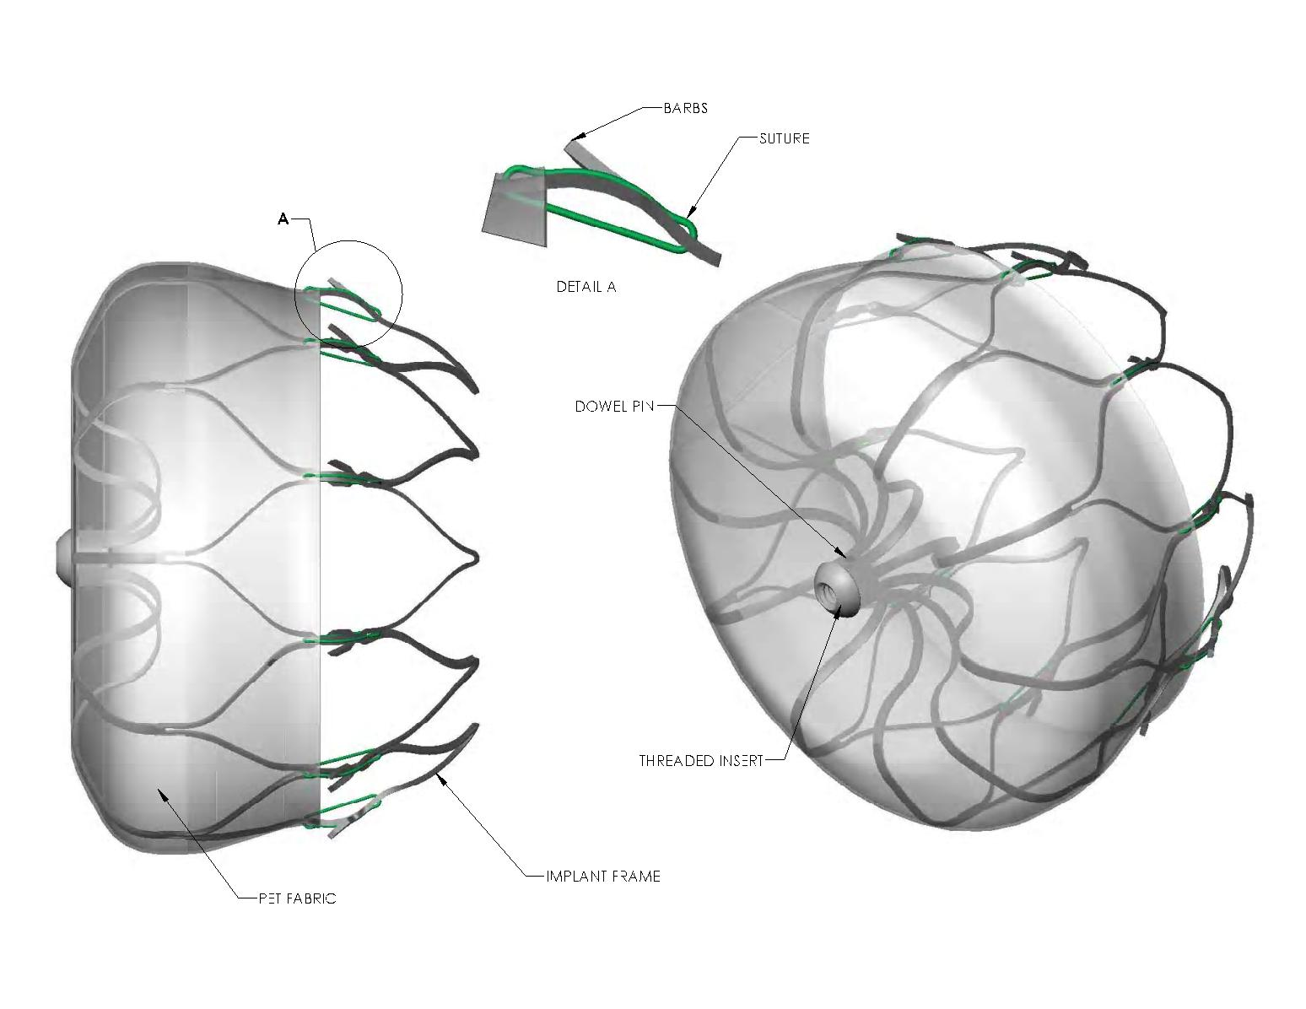
WATCHMAN® LAA Closure Technology
3000838-20

Slide 12
PROTECT AF Clinical Trial Design
Prospective, randomized study of WATCHMAN LAA Device vs long-term warfarin therapy
2:1 allocation ratio device to control
800 patients enrolled from Feb 2005 to Jun 2008
Device group (463)
Control group (244)
Roll-in group (93)
59 enrolling centers (U.S. & Europe)
Follow-up requirements
TEE follow-up at 45 days, 6 months and 1 year
Clinical follow-up biannually up to 5 years
Regular INR monitoring while taking warfarin
Enrollment continues in Continued Access Protocol (CAP Study)
3000838-27

Slide 13
Key Participation Criteria
Key inclusion criteria
Age 18 years or older
Documented non-valvular AF
Eligible for long-term warfarin therapy, and has no other conditions that would require long-term warfarin therapy
Calculated CHADS2 score ≥1
Key exclusion criteria
NYHA class IV congestive heart failure
ASD and/or atrial septal repair or closure device
Planned ablation procedure within 30 days of potential WATCHMAN Device implant
Symptomatic carotid disease
LVEF <30%
TEE criteria: suspected or known intracardiac thrombus (dense spontaneous Echo contract
3000838-29

Slide 14
PROTECT AF Trial Endpoints
Primary efficacy endpoint
All stroke: ischemic or hemorrhagic
Deficit with symptoms persisting more than 24 hours or
Symptoms less than 24 hours confirmed by CT or MRI
Cardiovascular and unexplained death: includes sudden death, MI, CVA, cardiac arrhythmia and heart failure
Systemic embolization
Primary safety endpoint
Device embolization requiring retrieval
Pericardial effusion requiring intervention
Cranial bleeds and gastrointestinal bleeds
Any bleed that requires ≥2uPRBC
Some events will be counted as both safety and efficacy endpoints
3000838-28

Slide 15
Intent-to-Treat Primary Safety Results
Device
Control
Events Total Rate Events Total Rate RR Cohort (no.) pt-yr (95% CI) (no.) pt-yr (95% CI) (95% CI)
600 pt-yr 45 386.4 11.6 9 220.4 4.1 2.85 (8.5, 15.3) (1.9, 7.2) (1.48, 6.43)
900 pt-yr 48 554.2 8.7 13 312.0 4.2 2.08 (6.4, 11.3) (2.2, 6.7) (1.18, 4.13)
Randomization allocation (2 device:1 control)
Device
ITT cohort: patients analyzed based on their randomly assigned group (regardless of treatment received)
Event-free probability
Control
900 patient-year analysis
Days
244
143
51
11
463
261
87
19
3000838-61

Slide 16
Specific Safety Endpoint Events
Pericardial effusions – largest fraction of safety events in device group
Stroke events – most serious fraction of safety events in control group
Bleeding events were also frequent
3000838-63

Slide 17
Safety Events Pericardial Effusion
Pericardial effusions – 47% of total device events
22 classified as “serious” (4.8% of patients)
7 required surgical intervention: extended hospitalization by 6 days
15 treated percutaneously: extended hospitalization by 4 days
None resulted in death
3000838-69

Slide 18
Pericardial Effusions by Experience
Throughout PROTECT AF Trial, procedural modifications and training enhancements were implemented
Procedural events would be expected to decrease over time
Pericardial effusions within 7 days of the procedure are most relevant to the device performance
Site implant group (includes roll-in subjects)
Any procedure/ device related
Any serious
Any
No. % No. % No. %
Early patients (1-3) 13/154 8.4 12/154 7.8 10/154 6.5
Late patients (≥4) 27/388 7.0 24/388 6.2 17/388 4.4
Total 40/542 7.2 36/542 6.6 27/542 5.0
3000838-70

Slide 19
Effusions in Recent Implant Experience
Rates obtained in the CONTINUED ACCESS Study confirm that the lower rates are sustained
Any procedure/ device related
Any serious
Any
No. % No. % No. %
1/88 1.1 1/88 1.1 1/88 1.1
3000838-71

Slide 20
Intent-to-Treat Primary Efficacy Results
Device
Control
Posterior probabilities
Events Total Rate Events Total Rate RR Non- Superiority Cohort (no.) pt-yr (95% CI) (no.) pt-yr (95% CI) (95% CI) inferiority
600 18 409.3 4.4 13 223.6 5.8 0.76 0.992 0.734 pt-yr (2.6, 6.7) (3.0, 9.1) (0.39, 1.67)
900 20 582.3 3.4 16 318.0 5.0 0.68 0.998 0.837 pt-yr (2.1, 5.2) (2.8, 7.6) (0.37, 1.41)
Randomization allocation (2 device:1 control)
WATCHMAN
ITT cohort: patients analyzed based on their randomly assigned group (regardless of treatment received)
Event-free probability
Control
900 patient-year analysis
Days
244
147
52
12
463
270
92
22
3000838-89

Slide 21
Intent-to-Treat Hemorrhagic Stroke
Device
Control
Posterior probabilities
Events Total Rate Events Total Rate RR Non- Superiority Cohort (no.) pt-yr (95% CI) (no.) pt-yr (95% CI) (95% CI) inferiority
600 1 416.7 0.2 4 224.7 1.8 0.13 0.998 0.986 pt-yr (0.0, 0.9) (0.5, 3.9) (0.00, 0.80)
900 1 593.6 0.2 6 319.4 1.9 0.09 >0.999 0.998 pt-yr (0.0, 0.6) (0.7, 3.7) (0.00, 0.45)
Device
Randomization allocation (2 device:1 control)
Control
ITT cohort: patients analyzed based on their randomly assigned group (regardless of treatment received)
Event-free probability
900 patient-year analysis
Days
244
147
53
12
463
275
95
23
3000838-103

Slide 22
Risk/Benefit Analysis
Intent-to-treat analysis
Primary endpoint (intent to treat) achieved
Other statistically significant endpoint findings
Noninferiority for the primary efficacy event rate – 32% lower in device group
Noninferiority for stroke rate – 26% lower in device group
Superiority for hemorrhagic stroke – 91% lower in device group
Noninferiority for mortality rate – 39% lower rate in device group
Increased rate of primary safety events for the device group relative to the control group
Most events in the device group were procedural effusions that decreased over the course of the study
87% of patients discontinued warfarin at 45 days
Death/disability conclusion
3000838-120

Slide 23
Risk / Benefit Analysis
Risk/Benefit Analysis
Per-protocol analysis
Superiority for the primary efficacy event rate
Approximately 86% of patients in the device group were able to be successfully implanted and discontinue warfarin therapy
Study demonstrates the role of the left atrial appendage in the pathogenesis of stroke due to AF
Based on average age, patients will experience a 56% reduction in safety events
3000838-122

Slide 24
Summary
Long-term warfarin treatment of patients with AF has been found effective, but presents difficulties and risk
PROTECT AF trial was a randomized, controlled, statistically valid study to evaluate the WATCHMAN device compared to warfarin
In PROTECT AF, hemorrhagic stroke risk is significantly lower with the device.
When hemorrhage occurred, risk of death was markedly increased
In PROTECT AF, all cause stroke and all cause mortality risk are equivalent to that with warfarin
In PROTECT AF, there are early safety events, specifically pericardial effusion; hese events have decreased over time
3000838-123

Slide 25
Conclusion
The WATCHMAN LAA Technology offers a safe and effective alternative to warfarin in patients with non-valvular atrial fibrillation at risk for stroke and who are eligible for warfarin therapy
3000838-124

