Slide 1
RANDOMIZATION
Arzu Kalayci, MD

Slide 2
Experimental Design
Randomization
Key feature of experiment
Other features
Standardized treatment
Prospective plan
Adverse event reporting
Regulatory requirements

Slide 3
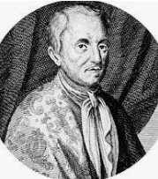
Fair Allocation in Health Care
“Let us take out of the hospitals… 200 or 500 poor people, that have fevers, plurisies. Let us divide them into halves, let us cast lots, that one half of them may fall to my share, and the other to yours; I will cure them without bloodletting and sensible evacuation; but you do, as you know... We shall see how many funerals both of us shall have.”
– Van Helmont, 1662
Source: Silverman and Chalmers. (2001). British Medical Journal,323,1467-1468.

Slide 4
Definitions
Random (lay)
Having no specific pattern; lacking causal relationship; haphazard (e.g., random acts of nature)
Random (scientific)
Process in which there is a probability associated with every legitimate outcome (e.g., coin-toss, dice throw, draw pocer)

Slide 5
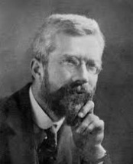
Introduction of Theory
Ronald A. Fisher (1890 – 1962)
Question was how to allocate plots, not whether
controls were needed
A measurement error issue
“One way of making sure that a valid estimate of error will be obtained is to arrange the plots deliberately at random…” (1926)
“The purpose of randomization... Is to guarantee the validity of the test of significance, this test being based on an estimate of error made possible by replication” (1951)
Other methods of allocation would either over-estimate or underestimate the random error
Some safeguard against non-normality

Slide 6
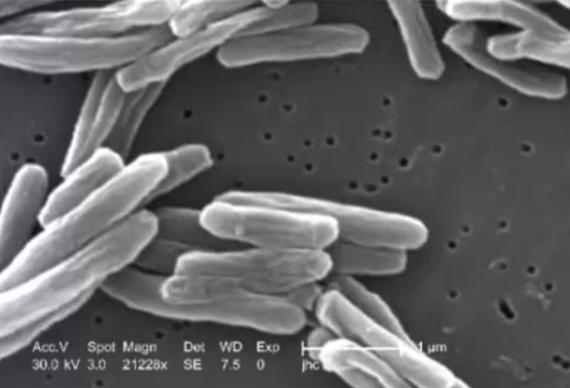
First Properly Randomized and Documented Trial
First properly randomized and DOCUMENTED trial
Trial of streptomycin for TB in 1946
Fair distribution of risk/benefits
Fair allocation of a limited resource

Slide 7
Rationale for Randomization
Avoids selection bias
Prognostic factors related to treatment assignment
Confounding by indication
Can influence outcomes as strongly as or more strongly than treatments
Tends to produce comparable treatment groups
Known and unknown confounders
Assures statistical tests (e.g., t-test, chi-square) will have valid significance levels (e.g., p = 0.03)
Defined time-point for trial entry

Slide 8
Rationale for Unequal Randomization
Example 1:1 with 95% power, 2:1 with 92%, 4:1 with 82%
Typically less powerful
Important to acquire as much experince with new treatment as possible including adverse events and toxicity
Incentive for recruitment, e.g., 2:1 patients have a 67% chance of getting new treatment.
Cost issues
Variance in treatment effect may be different, to optimize power more patients in group with larger variance

Slide 9
Types of Selection Bias
Epidemiologic definitions
Study group associations between intervention and outcome different than asociation in target population
Trial definition
Treatment associated with prognosis
Link broken with randomization

Slide 10
Types of Randomization Schemes
Simple randomization
Restricted randomization
Adaptive randomization

Slide 11
Simple Randomization: Advantages
Complete randomization, e.g., coin toss
Each new assignment is independent
Advantages
Each assignment is completely unpredictable
In the long run, number of patients assigned to each group should be about equal

Slide 12
Simple Randomization: Risks
Risks
Imbalances
Number of patients assigned / treatment group
Confounding factor by treatment group
Both lower statistical power
May diminish credibility of results
Inversely associated with number of participants

Slide 13
Restricted Randomization
Scheme with constrains to produce expected assignment ratio according to time and/or specified covariates
Blocking
Stratification

Slide 14
Restricted Randomization: Blocking
Block is a list of treatment assignments that achieve the the treatment allocation ratio, e.g., A:B =1:1
Block of size 4: 2As and 2Bs
List of possible permutations: AABB, ABAB, ABBA, BABA, BAAB, BBAA
Size of the smallest possible block is the sum of the integers defined in treatment allocation ratio
2 for 1:1 ratio (1+1), 3 for 2:1 ratio (2+1)
Larger block sizes are multiples of smallest one: 3,6,8,12
All possible block sequences are randomly permuted (to arrange in all possible ways)
Randomly chooses one of X permuted blocks
Ensure balance of treatments over time

Slide 15
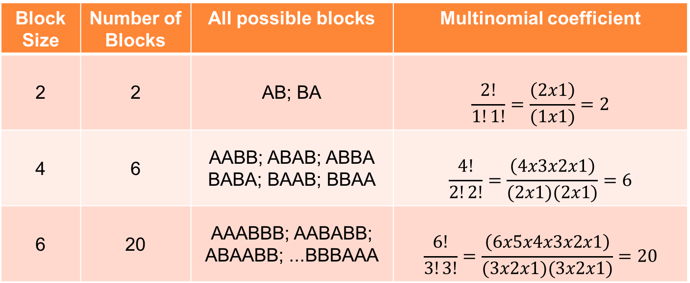
How Many Blocks?
Allocation ratio 1:1
Block Size | Number of Blocks | All possible blocks | Multinomial coefficient
2 | 2 | AB; BA | $$\frac{2!}{1!1!}=\frac{\left(2x1\right)}{(1x1)}=2$$
4 | 6 | AABB; ABAB; ABBA BABA; BAAB; BBAA | $$\frac{4!}{2!2!}=\frac{\left(4x3x2x1\right)}{(2x1)(2x1)}=6$$
6 | 20 | AAABBB; AABABB; ABAABB; ...BBBAAA | $$\frac{6!}{3!3!}=\frac{\left(6x5x4x3x2x1\right)}{(3x2x1)(3x2x1)}=20$$
Multinomial coefficient is the number of permutations of n things of k kinds, with r₁ of the 1st kind, r₂ of the 2nd kind, …, r_{k} of the kth kind, where r₁+ r₂+ r_{k} = n
$$\frac{n!}{r1!r2!…rk!}$$

Slide 16
Blocking Implementation
Fixed allocation ratio throughout trial
It is a secret!
Block sizes are on a need-to-know basis
Use more than one block size
Overall sequence appears more random
Protects against discovery
Especially in an unmasked trial

Slide 17
Blocking Pros/Cons
Advantages
Overall balance, especially in smaller trials
Protects against time-related changes
In the composition of study population
Data collection procedures
External forces being differential across treatment groups, i.e., secular trends, chronological bias
If trial is stopped early, have balanced groups
Analyses are more powerful
Disadvantages
Can facilitate prediction of future assignments
More problematic for unmasked trials or poorly masked trials

Slide 18
Restricted Randomization: Stratification
Ensure balance in treatment assignments within subgroups defined before randomization
Clinic, gender, risk level
Subgroup should be related to outcome – strong confounder or effect modifier
Requires a separate set of treatment assignments schedules for each category of each stratum

Slide 19
Stratification and Blocking Example
Breast cancer treatment
1:1 treatment allocation
A or B
Stratification
Center
X or Y
Postmenopausal status
Post or pre
Block size 4
Center | X |  | Y
Status | Post | Pre | Post | Pre
Blk | Tx Assignments
1 | B | B | A | B
1 | A | B | A | A
1 | B | A | B | A
1 | A | A | B | B
2 | A | A | A | A
2 | B | A | A | B
2 | A | B | B | B
2 | B | B | B | A
: | : | : | : | :

Slide 20
Practical Aspects of Stratification
Limit to a few (1-2) variables
Highly related to outcome
Logistical
Typical ones
Clinic in a multicenter trial
Surgeon, interventional cardiologist
Stage of disease
Demographic characteristics (gender, age)
Too many strata may lead to imbalances in overall treatment group allocation

Slide 21
Adaptive Randomization - Definition
A process in which the probability of assignment to the treatments… does not remain constant, but is determined by the current balance and/or composition of the groups (Piantadosi, 1997)

Slide 22
Adaptive Randomization
Minimization – after randomizing the first patient, the treatment assignment that yields the smallest imbalance is chosen
Balance marginal treatment totals across prognostic factors
Handle many more factors than stratification
Need to know their value before randomization
Allocation sequence cannot be determined in advance
Play the winner – change treatment allocation ratio to favor the better treatment based on the primary outcome
Preferentially assigns patients to better treatment
Need to evaluate outcome relatively quickly
May implement in stages

Slide 23
THANK YOU

