Slide 1
The role of the principal investigator in Clinical Trials
Clara Fitzgerald, MPH

Slide 2
Clinical Trial Management Structure
Steering Committee
Industry sponsor
Regulatory Agencies
Independent Data Monitoring Committee (DSMB)
Statistical Analysis
Center
Site & Data Management Center
Central Units Core Labs
CEC
Clinical Investigators
Adapted from M. Fisher, E. Roecker, D. Demets. Drug Inf J. 2001;35:115

Slide 3
Clinical Trial Research Team
Principal Investigator (PI)
Sub Investigator (Sub I)
Clinical research Nurse Coordinator (CRNC)
Clinical research Coordinator (CRC)
Regulatory Coordinator
Other personnel as needed

Slide 4
Principal Investigator
“A physician who leads the conducts of a clinical investigation at a study site or, in the event of an investigation conducted by a team of individuals, is the responsible leader of the team”
Responsible for ensuring:
Study is conducted in accordance with Good Clinical Practice (GCP)
The rights, safety and well-being of trial participants is protected
Results of the trial are accurate and credible

Slide 5
Principal Investigator Responsibilities
21 CFR 312.60: An Investigator is responsible for ensuring that an investigation is conducted according to the signed investigator statement, the investigational plan, and applicable regulations; for protecting the rights, safety and welfare of the subjects under the investigator’s care; and for the control of the drugs under investigation
Protocol compliance
Informed consent prior to study procedures
Record keeping and retention
Control of investigational drug
IRB review & approval
Adverse event reporting
Integrity of data/inspection of records
Adapted from K. O’Malley, Jefferson Clinical Research Institute
Notes:
Control of drugs under investigation
Ensuring that informed consent is adequately obtained according to 21 CFR 50
Ensuring IRB review, approval and reporting
requirements are met per 21 CFR 56
Control of investigational drug (312.61)
Record keeping and retention (312.62)

Slide 6
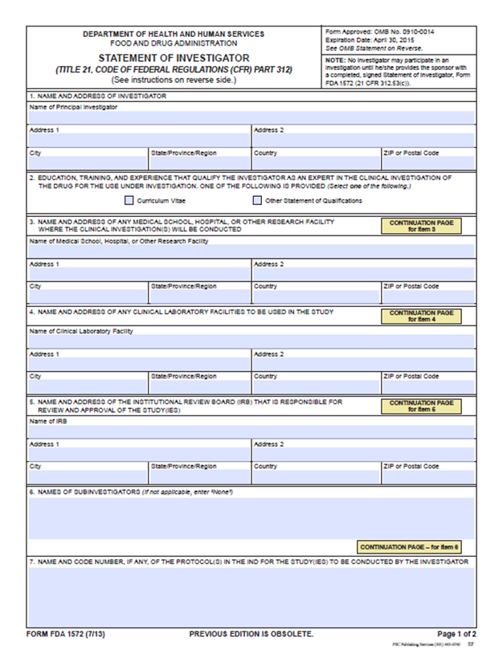
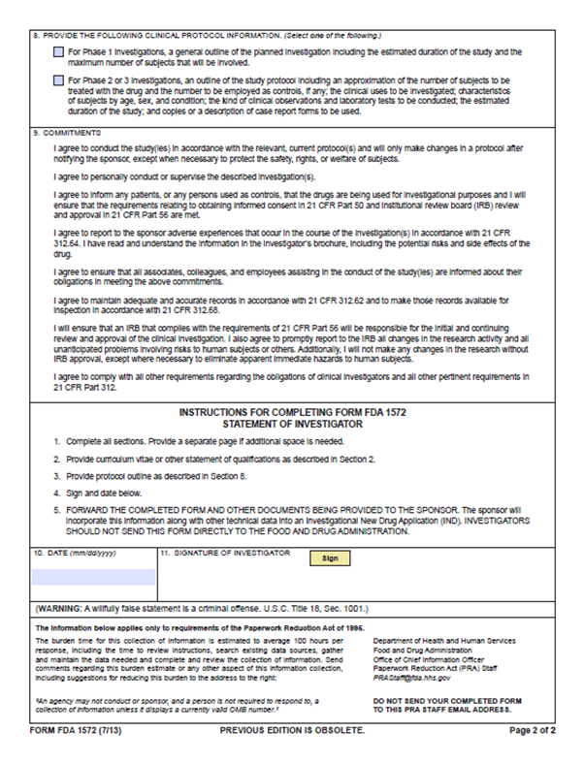
Form FDA 1572
Form FDA 1572 is a contract between the sponsor and the investigator
Signed before a clinical trial involving an investigational drug can begin
Used in IND studies (investigational new drug)
Notes:
http://www.fda.gov/downloads/AboutFDA/ReportsM anualsForms/Forms/UCM074728.pdf

Slide 7
FORM FDA 1572
Personally conduct or supervise investigation
Follow protocol- only make changes after notifying the sponsor unless subject at risk
Ensure all persons assisting with the study are informed of obligations
Inform subjects that drugs are being used for investigational purposes
Ensure informed consent (21 CFR Part 50) and IRB review, approval and reporting (21 CFR Part 56)
Report to sponsor adverse events (21 CFR 312.64); read and understand the IB.
Adapted from Cynthia F. Kleppinger, M.D. FDA’s 2013 Clinical Investigator Training Course

Slide 8
FORM FDA 1572
Maintain adequate and accurate records (21 CFR 312.62) and make them available for inspection in accordance with 21 CFR 312.68
Ensure initial and continuing review by an IRB and report all changes to research and unanticipated problems involving risks to subjects, not make any changes without IRB approval except where necessary to eliminate immediate hazards
Comply with other requirements in 21 CFR 312
Adapted from Cynthia F. Kleppinger, M.D. FDA’s 2013 Clinical Investigator Training Course

Slide 9
Investigator Reports
Progress reports to sponsor
Safety reports
Immediately report any adverse event that is alarming (e.g. an unexpected event that is serious or life-threatening)
Record nonserious adverse events and report them to the sponsor according to the timetable for reporting specified in the protocol
Final report to sponsor
Financial disclosure to sponsor (21 CFR 54)
Promptly update as needed during the course of the investigation and for 1 year following study completion
Adapted from Cynthia F. Kleppinger, M.D. FDA’s 2013 Clinical Investigator Training Course

Slide 10
Guidance Documents
FDA Information Sheet
E6 Good Clinical Practice Consolidated Guidance
Notes:
“The objective of this ICH GCP guidance is to provide a unified standard for the European Union (EU), Japan, and the United States to facilitate the mutual acceptance of clinical data by the regulatory authorities in these jurisdictions”.
In general the E6 is more detailed guidance, however the FDA regulations are more explicit in the IRB sections

Slide 11
Research Team Members
Sub-investigator
Designated and supervised by the PI to perform study-related procedures and make study-related decisions
Clinical Research Nurse Coordinator / Clinical Research Coordinator
Supports clinical research as needed
Regulatory Coordinator
Maintains IRB submissions and all regulatory approval documents

Slide 12
Additional Reading
FDA ‘Investigator Responsibilities- Regulation and Clinial Trials’ Cynthia F. Kleppinger, M.D. <https://www.fda.gov/files/science%20%26%20research/published/9-45---11-00-Investigator-Responsibilities-%E2%80%93-Regulation-and-Clinical-Trials.pdf>

