Slide 1
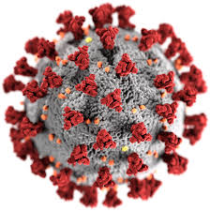
Sepsis
SARS-CoV-2
Acute Kidney Injury
Hypotension
Hypoxemia
Cytokine storm
Blood clots

Slide 2
IL-6
Lung Endothelial cell injury
ARDS
Renal
Tubular cell injury
Hypoxia

