Slide 1
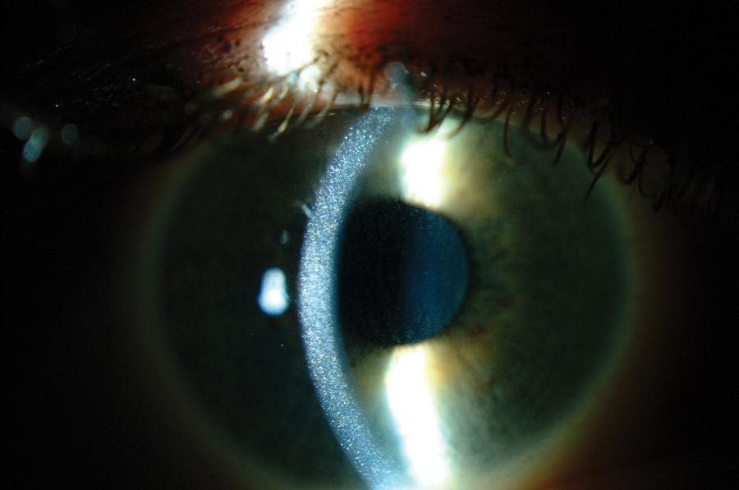
Slit-lamp photography of corneal cystine crystals. Corneal crystals appear as needle-shaped and highly ...
Notes:
FIGURE 2: Slit-lamp photography of corneal cystine crystals. Corneal crystals appear as needle-shaped and highly reflective crystals within the cornea (original photograph provided by Dr. A. Labbé).
Unless provided in the caption above, the following copyright applies to the content of this slide: © The Author 2014. Published by Oxford University Press on behalf of ERA-EDTA. All rights reserved.

