Slide 1
Reporting and Interpreting results II Data Presentation and Visualization
Clara Fitzgerald, MPH

Slide 2
Presentation of Data for Clinical Trials
Raw datasets
Electronic CRF
Analysis Data Model (ADAM) datasets
Study Data Tabulation Model (SDTM) datasets
Tables, Listings & Figures (TLF)

Slide 3
Presentation of Data for Clinical Trials
https://www.lexjansen.com/pharmasug/2018/MD/PharmaSUG-2018-MD06.pdf

Slide 4
Derivation of ADAM Datasets
Gibson CM, Goldhaber SZ, Cohen AT, Nafee T, Hernandez AF, Hull R, Korjian S, Daaboul Y, Chi G, Yee M, Harrington RA. When academic research organizations and clinical research organizations disagree: Processes to minimize discrepancies prior to unblinding of randomized trials. Am Heart J. 2017 Jul;189:1-8. doi: 10.1016/j.ahj.2017.03.018. Epub 2017 Mar 31. PMID: 28625365.

Slide 5
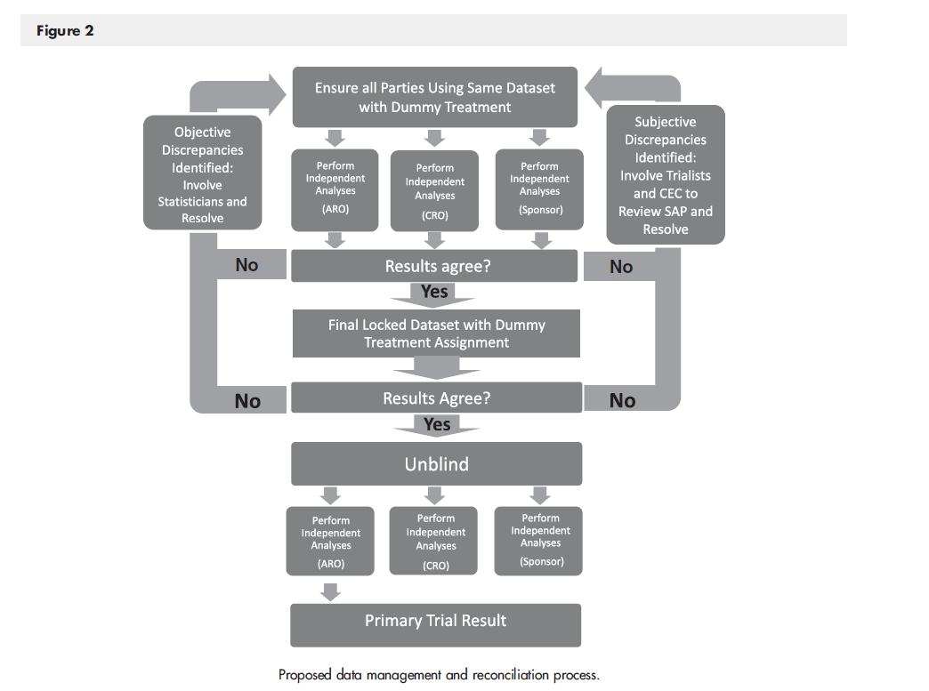
Derivation of ADAM Datasets
Gibson CM, Goldhaber SZ, Cohen AT, Nafee T, Hernandez AF, Hull R, Korjian S, Daaboul Y, Chi G, Yee M, Harrington RA. When academic research organizations and clinical research organizations disagree: Processes to minimize discrepancies prior to unblinding of randomized trials. Am Heart J. 2017 Jul;189:1-8. doi: 10.1016/j.ahj.2017.03.018. Epub 2017 Mar 31. PMID: 28625365.

Slide 6
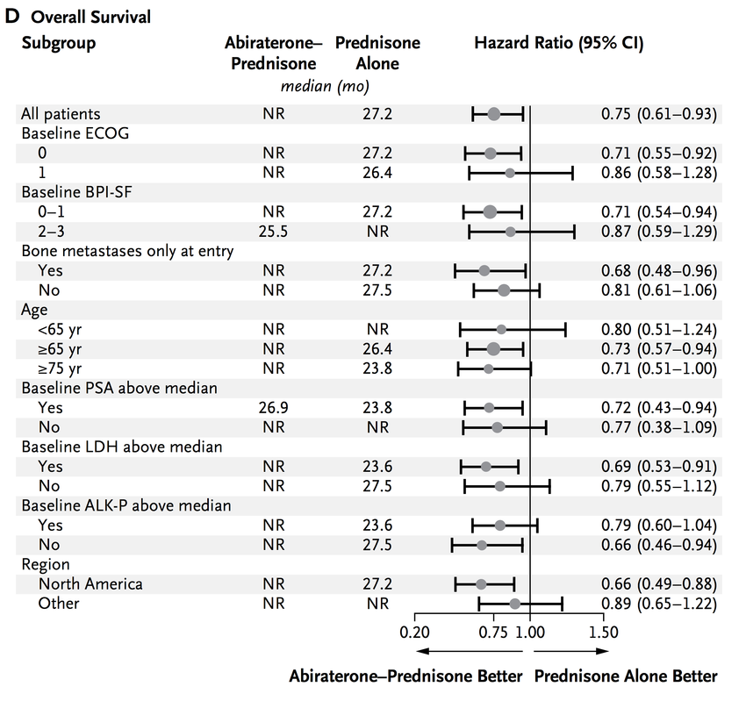
Tables
Table 1. Baseline Demographics and Characteristics
Table 2- Table X. – Based on trial objectives / statistical analysis
Figures
Flow diagram
Kaplan Meier plot
Forest plot (subgroup analyses)
http://www.nejm.org/doi/full/10.1056/NEJMoa1209096

Slide 7
Data Visualization

Slide 8
Importance of Data Visualization
Communicate and understand large datasets
Effective data visualizations can communicate simple take home messages
Make large datasets accessible
Strong data visualizations are intuitive and accurate
Visuals communicate information faster than text
Notes:
The use of visual content has a profound effect on our brains’ ability to learn and process new information. A combination of words and pictures has proven time and again to be a more effective teaching tool than words alone.
More than 80% of what your brain processes is visual

Slide 9
Presentation of Data Do’s and Don’ts
Keep it simple
Pie charts
Bar charts
Line graphs
Include clear titles and labels to point out important aspects
Use color intentionally

Slide 10
Presentation of Data Do’s and Don’ts
Don’t
Misrepresent data
Inaccurate scales
Uneven axis or intervals
Misleading colors
Try to present too much information
Crowded chart is difficult to understand
Compare different measurements (such as percentages and rates) in one chart

Slide 13
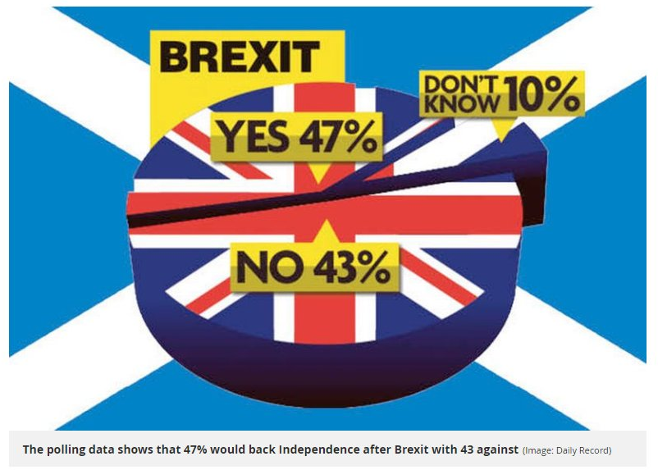

Slide 15
Notes:
you should avoid comparing different measures (i.e. percentage vs. ratio vs. rate) in the same chart.

Slide 17
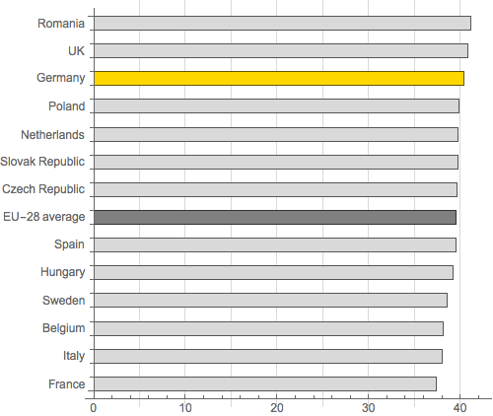

Slide 18
Data Visualization
Tableau
Desktop ($)
Public (free, but visualizations are publicly available)
Visualization of the day-
https://public.tableau.com/en-us/gallery/?tab=viz-of-the-day&type=viz-of-the-day
https://public.tableau.com/en-us/gallery/life-span-animals?tab=featured&topic=industry-healthcare-and-life-sciences

