Slide 1
Parallel, Crossover, and Group
Allocation Designs
Arzu Kalayci, M.D.

Slide 2
Parallel Design
Simultaneous treatment and control groups
Each person is randomly assigned to one treatment group
Randomization removes treatment selection bias and promotes comparability of treatment groups
Statistical comparisons made between treatment groups

Slide 3
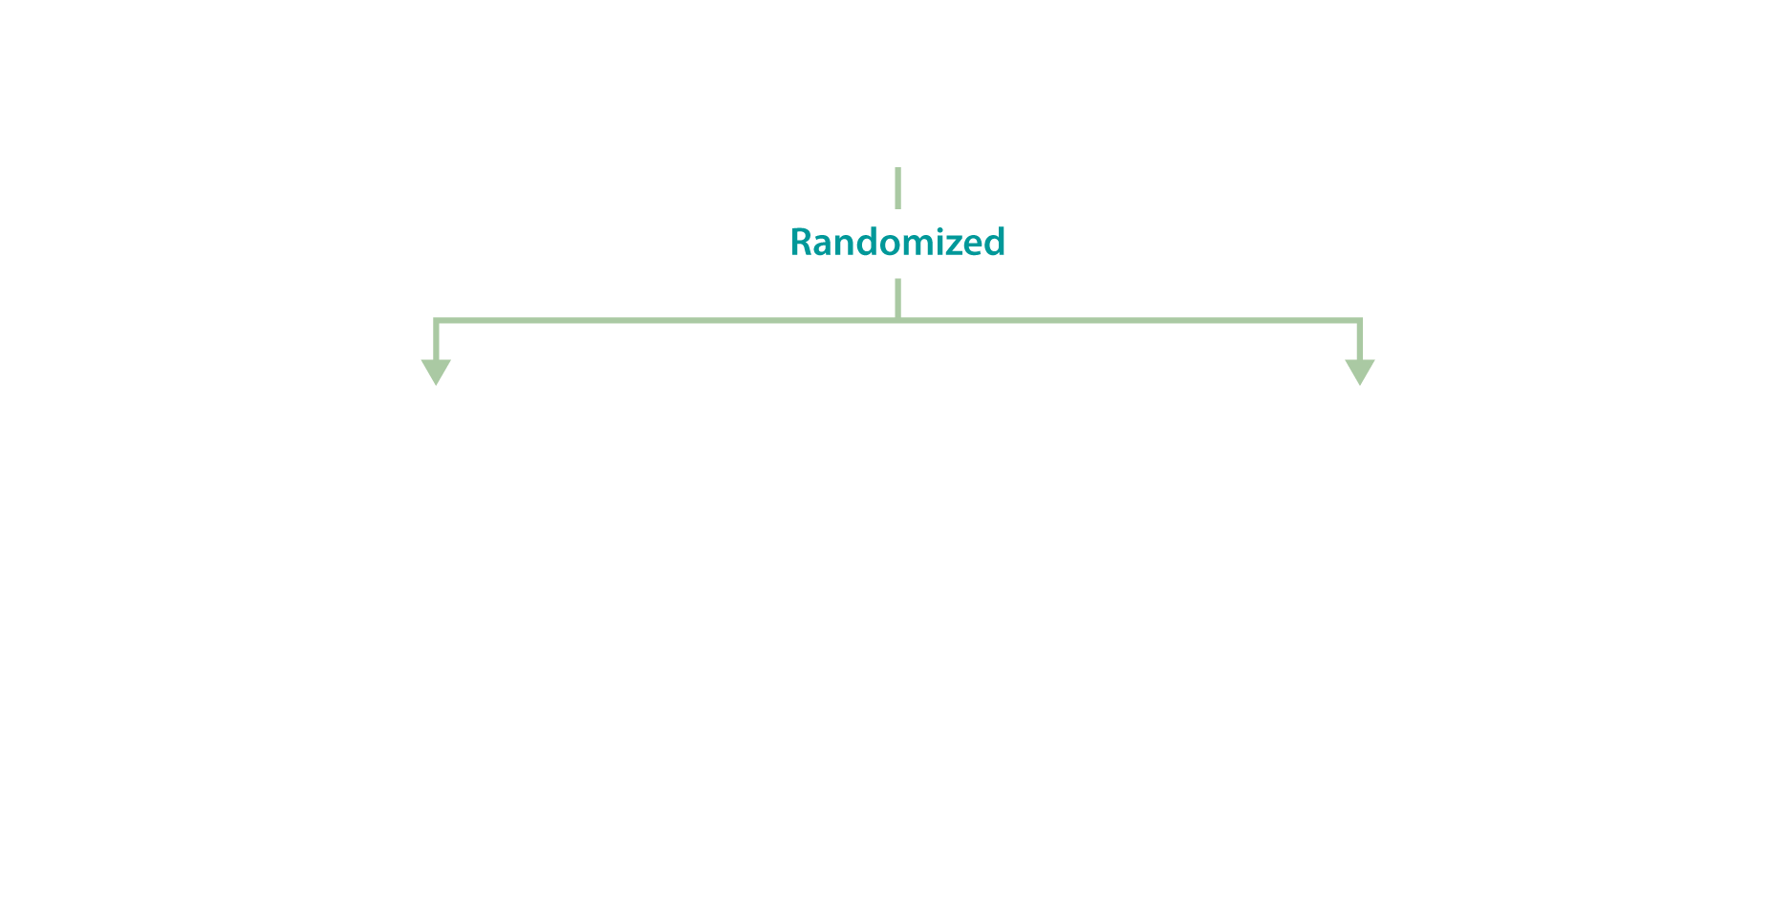
Parallel Design Graph
Defined population
New treatment
Current treatment
Improved
Not improved
Improved
Not improved

Slide 4
Crossover Design
Randomization of order in which treatments are received
AB or BA
Randomization promotes balance between treatment groups in timing of exposure
Testing of both treatments in each patient
Each patient serves as his/her own control
Variability reduced because less variability within patient than between patients
Fewer patients needed

Slide 5
Crossover Design Graph
Group 1, Tx A Group 2, Tx A
Group 2, Tx B
Group 1, Tx B
Washout

Slide 6
Crossover Design: Disadvantages
Treatment can’t have permanent effects or cures
Potential carry-over effects of first-period treatment to second period
Washout needs to be long enough
Unequal carry-over effects
Treatment during washout
Test for period by treatment interactions not powerful
Dropouts more significant
Analysis may be more difficult

Slide 7
Crossover Design: Uses
Constant intensity of underlying disease
Chronic diseases—asthma, hypertension, arthritis
Short-term treatment effects
Relief of signs or symptoms of disease
Metabolic, bioavailability, or tolerability studies

Slide 8
Group Allocation Design
Also known as “cluster randomization”
Randomization unit is a group of individuals (community, school, clinic)
Individual randomization and intervention is not feasible or is unacceptable
Tracking
Contamination
If there is a correlation in the responses within a group, design loses some efficiency (more individuals required)

Slide 9
Group Allocation Design Graph
Paired groups
Intervention
No intervention
Improved
Not improved
Improved
Not improved

Slide 10
Factorial and Large Simple Designs

Slide 11
Factorial Design
Two interventions tested simultaneously, either as…
Economical way to test two treatments simultaneously, or
Method to test for treatment interaction
For testing two treatments simultaneously, assumption is of no interaction
Treatments have independent mode of action
More plausible if different outcome

Slide 12
Factorial Design Graph
Treatment B
+
-
+
Both A and B
A but not B
A,
w/wo B
Treatment A
-
B but not A
Neither A nor B
No A,
w/wo B
B,
w/wo A
No B,
w/wo A

Slide 13
Factorial Design: Comparisons
Estimation of main effects, if no interaction expected
Use numbers in the margins
A vs. no A, regardless of assignment to B
B vs. no B, regardless of assignment to A
Assessment for interaction
Is response in A and no A different among those receiving B or no B?
May have limited power to detect interaction

Slide 14
Factorial Design Graph
Treatment B
+
-
+
Both A and B
A but not B
A,
w/wo B
Treatment A
-
B but not A
Neither A nor B
No A,
w/wo B
B,
w/wo A
No B,
w/wo A

Slide 15
Factorial Design Example: ISIS - 3
International study of Infarct Survival-3
Factorial Design: 3x2
Aspirin + heparin vs. aspirin alone (antithrombotic)
Streptokinase vs tPA vs. APSAC (fibrinolytic)
Large, simple trial
41,299 patients
914 hospitals
20 countries

Slide 16
ISIS- 3 Treatments
ISIS-3 Collaborative Group (1992). Lancet 339: 753-770.

Slide 17
Large, Simple Design
Features
Very large number of patients (many study sites)
Broad eligibility criteria
Minimal data collection requirements
Rationale
Modest benefits require large sample sizes
Treatment interactions unlikely, so baseline characteristics and interim response variables are not needed
Less precision (more error, increased variance) is tolerated; countered with large numbers

Slide 18
Large, Simple Design: Requirements
Easily administered intervention
Short-term adherence
No treatment adjustment
No ongoing monitoring for adverse events
Easily ascertained outcome
Short-term follow-up?
No complex baseline measurements
Simple data are persuasive enough

Slide 19
ISIS-3 Methods
No baseline form, randomization by phone call
Treatment conveniently packaged
Use of ancillary treatment not restricted
One-page form at discharge for in-hospital events
Follow-up for mortality only, used government records when possible
ISIS-3 Collaborative Group (1992). Lancet 339: 753-770.

Slide 20
Thank you

