Slide 1
PERFUSE Clinical Trial Course Data Review Committee III, Data and Safety Monitoring Board
Sam Ciaranca
Clinical Review
Baim Institute for Clinical Research
Notes:
Welcome everyone….. DSMB...

Slide 2
Agenda
Purpose of Data and Safety Monitoring Board (DSMB)
Brief History
DSMB Format
DSMB Responsibilities
Sponsor Responsibilities
Differences regarding CEC/DMAC
Where is a DSMB applicable?
DSMB Recommendations
Example of DSMB Action
Notes:
Wanted to provide a quick outline of my talk today…

Slide 3
Data Safety Monitoring Board
A Data Safety Monitoring Board (DSMB), a.k.a Data Monitoring Committee (DMC), is a panel of experts in their respective fields of medicine that regularly reviews aggregate safety and efficacy data from an active clinical trial
The goal of the DSMB is to ensure patient safety in an unbiased manner, typically through the duration of trial enrollment
DSMB Chair, Members
Experience in fields related to the clinical area of study
Notes:
DSMB/DMC are interchangeable. Note that there is a chair and members with different responsibilities (we’ll get into this a little bit later). The experts’ fields are related to the clinical trial. Ideally members with prior DSMB/DMC experience. Data & Safety Review is in pursuit of patient safety, as well as scientific merit and validity, in some cases efficacy

Slide 4
History
1960s: Basic DSMBs emerge as an element to large, multi-center federally-funded trials with objectives of increased survivability and major morbidity reduction
National Institute of Health (NIH), Department of Veterans Affairs (VA)
1967: External Advisory Group recommends the creation of a formal committee to review safety, efficacy, and trial conduct to the National Heart Institute (NHI)
Why not an in-house committee?
Notes:
DSMBs arose out of an organic need for further data and safety monitoring by those who have experience and can quickly understand the implications of what they’re reviewing. Larger trials produce more data, and therefore require trained eyes. The push for external safety committees for clinical trials originated with the NIH and VA. Additionally, and more importantly, the committee cannot be in-house or directly involved in the trial as that raises questions of bias. Individuals who are closely involved with trial design and conduct may not be fully objective in reviewing the interim data for emerging safety or data validity concerns.
No in-house committee in case they see a signal in the data and decided to tweak the protocol to paint the data in a more positive light.

Slide 5
History
1992: NIH workshop comprised of experts in clinical research began to discuss and dictate the fundamental aspects and general formatting of DSMBs
DSMBs became more common and standardized due to:
Increased collaboration between the federal government and industry
A greater number of higher risk trials with mortality concerns or major morbidity endpoints
General awareness of clinical trial conduct resulting in possibly biased results
Institutional Review Boards (IRB) had concerns regarding regular trial oversight
Notes:
1992 represents when the more recognizable DSMB format started becoming standard.
Federal government requires DSMB for most trials they are involved with
Trials like heart valve trials the Baim works on, carry higher risk due to patient populations and nature of the intervention
IRBs wanted further safeguards put in place. IRBs are restricted in that they only safeguard their specific institution. DSMBs represented a more wide-spanning, general approach.

Slide 6
DSMB Format
FDA recommendations do not provision for any one, specific format of DSMB
Average, minimum quorum of 4 members
Chair, Members, Biostatistician
Facilitation Team
No Conflicts of Interest (COI)
Notes:
There are many different iterations of DSMBs in use and the FDA does not recommend any one, specific format. Importance is placed more on having an appropriate quorum with expertise directly related to the area of study and the data being produced.
A DSMB is often composed of a Chair, Members, and Biostatistician, though this does not always represent the breakdown. Biostatisticians sometimes have voting powers, sometimes not, but we’ll get to that in a couple slides.
A facilitation team or lead is on-hand to ensure that the meeting runs smoothly and that all necessary documents and attendees are present.

Slide 7
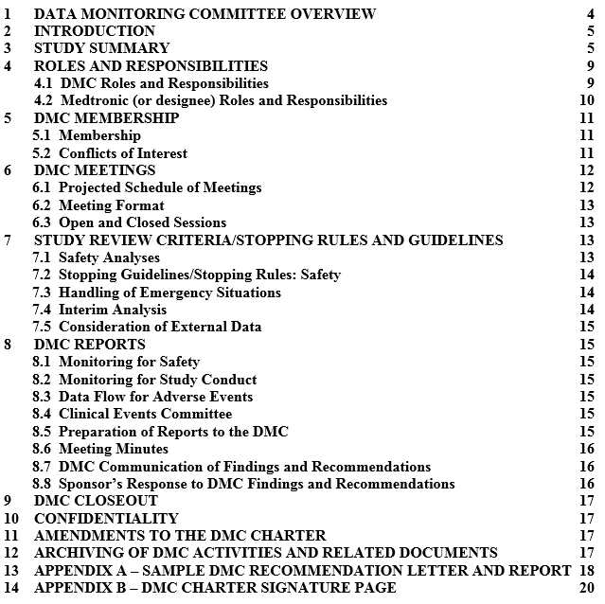
DSMB Format
Open & Closed Sessions
Meeting Minutes
Action Items Letter
Recommendation Letter
DSMB Charter
Meeting Schedule
Notes:
DSMB meetings are typically characterized by a dual meeting style, made-up from one open session and one closed session. The open session allows for the sponsor to review blinded data and to answer any questions from the DSMB members. This is also the time for sponsor staff to present study updates, such as enrollment numbers. The CLOSED session restricts any sponsor staff or individuals associated with the trial from reviewing unblinded data. If these people are allowed to view the unblinded trial data, it will result in the same bias concerns as if the DSMB was an in-house committee.
Meeting minutes – recorded meetings. Allows for writing of the minutes. Formal submission to the FDA at the end of the trial. Allows for looking back at various benchmarks and questions for both members, sponsor, and facilitation staff.
Meeting schedule is often quarterly, biannual and depends wholly on enrollment cadence and the expected rate of events.

Slide 8
DSMB Responsibilities
Delineated by DSMB Charter
Ensure all randomized patients are followed-up with
Review independently prepared data reports
Recommendations regarding trial continuation:
Continue without modification
Continue with modification
Study should be put on hold
Study should be stopped
Notes:
FDA acknowledges that there is no single, correct way to structure a DSMB. Their responsibilities are, as noted previously, laid out by the DSMB Charter

Slide 9
Sponsor Responsibilities
Sponsor is the organization responsible for the clinical trial and its initiation (21 CFR 50.3(e); 21 CFR 312.3; 21 CFR 812.3(n)), and maintaining Investigational New Drug Application/Investigation Device Exemption (IND/IDE) (21 CFR 312.40(a)(1); 21 CFR 812.40)
Must inform investigators and IRBs of any DSMB recommendations
Must provide aggregate safety and efficacy data to the DSMB
Staff present on Open DSMB Meetings
Sponsor is NOT required to accept the DSMB's recommendations
Notes:
If the sponsor decides not to accept DSMB recommendations, then they will likely need to proactively inform IRBs and sites why they made the decision.

Slide 10
Differences with CEC, DMAC
Clinical Events Committees (CEC) adjudicated specific, pre-defined adverse events and help to monitor trial safety on a more focused level than DSMBs
CECs also help to generate data for DSMBs to review
Data Monitoring and Adjudication Committees (DMAC) are combinations between DSMBs and CECs, both reviewing aggregate safety and efficacy data while adjudicating adverse events
DMACs can come about for budgetary or trial size reasons

Slide 11
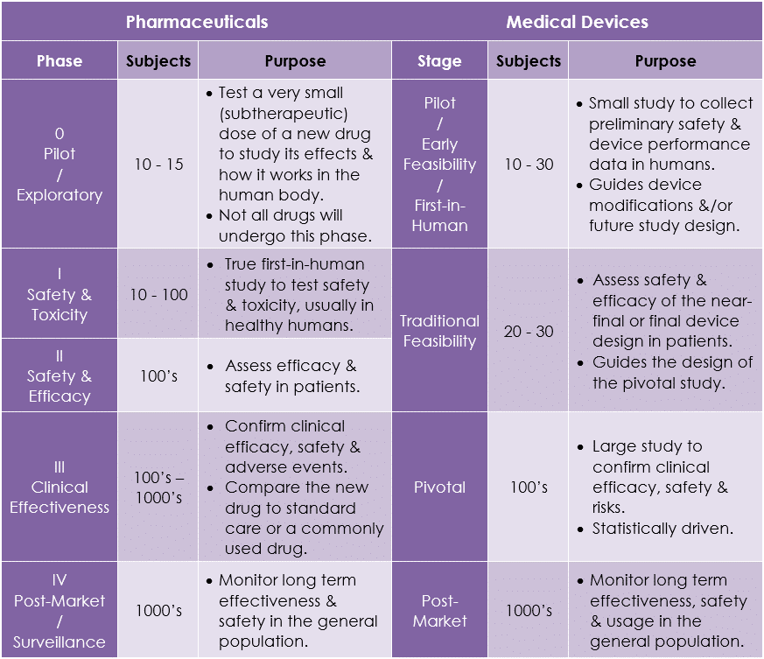
Trial Phase Reminder
https://www.researchgate.net/figure/Characteristics-of-Clinical-Trial-Phases_tbl4_301745695
Notes:
Review of Phase 1-3 trials. Gradually larger and large sample size. Greater risks

Slide 12
Applicability
Applicable:
FDA does not formally require DSMBs for trials except when research is performed in emergency settings where informed consent is excepted, as dictated by 21 CFR 50.24(a)(7)(iv)
Most Phase III studies require a DSMB
The involvement of a DSMB may still be recommended for low-risk studies if the studies have extenuating circumstances
Phase II studies which are "high risk" require a DSMB
Clinical trials of diseases with high mortality/morbidity, involving high risks, and large, multicenter clinical trials
When futility at interim analysis may ethically require study termination
Particularly vulnerable study populations
Notes:
with the exception of low-risk behavioral and nutritional studies. Areas where side-effects are expected to be minor and the intervention minor as well.
"high-risk" means trials of interventions associated with substantial side effects to subjects (e.g., side effects that could result in serious morbidity or death, or are irreversible), trials of diseases associated with high mortality or morbidity, and trials of highly experimental therapies

Slide 13
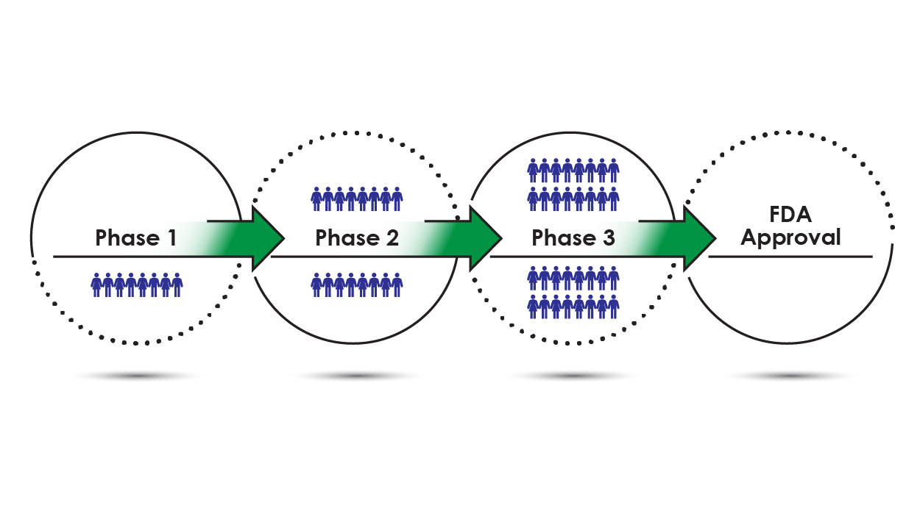
Applicability
Not applicable:
Single-center Phase I, II Trials
A multicenter, high-risk Phase I with stopping rules
Quick, brief trials
https://www.concertpharma.com/understanding-clinical-trial-terminology-whats-a-phase-1-2-or-3-clinical-trial/
Notes:
as data will be readily available throughout the trial to the local investigator. In this case, an independent medical monitor may be a more appropriate option
clinical trial should not require a DSMB if there are very clear rules for stopping the trial.

Slide 14
DSMB Recommendations
Review Open and Closed Data Reports in separate meeting sessions
Ask questions and engage in discussion
Generate action items and vote on a DSMB recommendation
Send recommendation letter and action items to Sponsor
Sponsor formally replies to recommendation letter and action items
FDA contacted to review recommendations, if deemed necessary
Recommendation letter contents shared with investigational site staff, including IRBs

Slide 15
Example of DSMB Action
A DSMB composed of 1 heart failure specialist, 1 pulmonary vascular disease specialist, 1 interventional cardiologist, 1 cardiologist, and 1 biostatistician work on a trial
Trial Design: Multicenter, prospective, randomized controlled, double blinded trial, with a non-implant control group; 1:1 randomization, hundreds of subjects. Patients randomized to the control arm will be allowed to cross-over to the treatment arm at 24 months post-control procedure provided patient selection criteria are met at that time. Control group is provided with standard of care treatment
Trial Device: An internal shunt designed to ameliorate symptoms of Heart Failure (HF)

Slide 16
Example of DSMB Action
The DSMB reviews the data provided in the Closed Report. Enrollment of subjects has finished. They examine tables displaying event rates in subjects
They note that, at 6 months and 1 year, subjects in the study who have received the device experience a greater frequency of Atril Fibrillation (AFib) and Major Adverse Cardiovascular Events (MACE) when compared to the control group to a statistically significant degree
Kaplan-Meier Curves for freedom from HF show that subjects who have received the device experience statistically greater HF events
DSMB recommends...

Slide 17
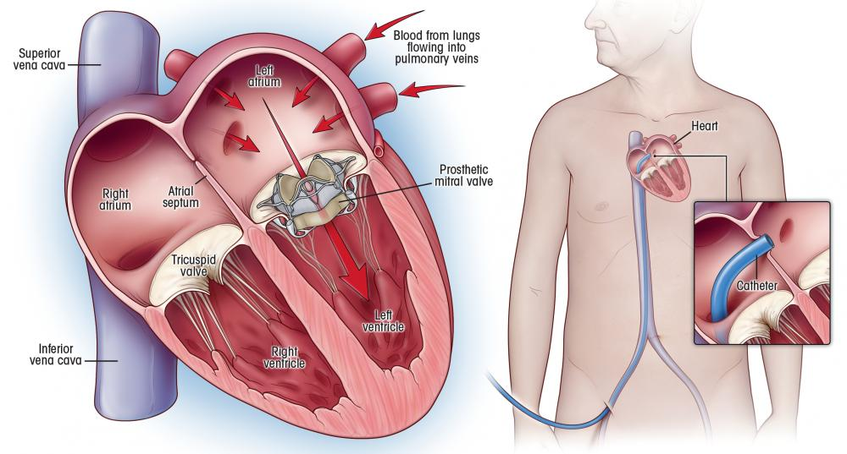
Example of DSMB Action
The DSMB recommends halting patients crossing over from the control arm to the treatment arm while maintaining the remainder of the study
Why maintain study follow-up?
Safety and Efficacy data intertwined in this example
https://nyulangone.org/news/remarkable-technique-replace-heart-valves-spares-patients-surgery

Slide 18
References
Center for, Biologics Evaluation and Research. “Establishment and Operation of Clinical Trial Data Monitoring Committees.” U.S. Food and Drug Administration, FDA, Mar. 2006, www.fda.gov/regulatory-information/search-fda-guidance-documents/establishment-and-operation-clinical-trial-data-monitoring-committees.
Lin, J. Y., & Lu, Y. (2014). Establishing a data monitoring committee for clinical trials. Shanghai archives of psychiatry, 26(1), 54–56. https://doi.org/10.3969/j.issn.1002-0829.2014.01.009
Clinical Trials Transformation Initiative. Data Monitoring Committees: project summary, http://www.ctti-clinicaltrials.org/what-we-do/cttiprojects/dmcs (accessed 23 February 2016).
Dental and Craniofacial Research, National Institute of. “Data and Safety Monitoring Board (DSMB) Guidelines.” National Institute of Dental and Craniofacial Research, U.S. Department of Health and Human Services, July 2018, www.nidcr.nih.gov/research/human-subjects-research/toolkit-and-education-materials/interventional-studies/data-and-safety-monitoring-board-guidelines.
School of Medicine, University of North Carolina. When Is a DSMB Needed?, 2021, tracs.unc.edu/index.php/services/regulatory/data-and-safety-monitoring-board/when-is-a-dsmb-needed.

