Slide 1
Clinical Trials & Medical Research Course
Phase II Study Designs
Serge Korjian M.D.
Clinical & Research Cardiology Fellow
Beth Israel Deaconess Medical Center
Harvard Medical School

Slide 2
Phase II Trials
Main Purpose: Investigating for preliminary evidence of efficacy and continuing to monitor safety/side effects in patients with the disease of interest
Only 30% of drugs/devices proceed to phase III testing.

Slide 3
Phase II Trials
Phase IIa: Early phase trials, generally small in size N<100, often single arm, pilot studies/proof of concept, can help identify optimal dosing.
Phase IIb: Later phase, studies designed to demonstrate clinical efficacy or biological activity, usually N<300,often randomized and placebo controlled, precursors to phase III trials

Slide 4
Challenges for Phase II Trials
The main challenge for phase II trial design includes the need to identify drugs that are safe with sufficient activity for phase III testing.
Phase II is usually the first time patients with the disease of interest are being recruited, which is a challenge by itself
Given the small size of the trials, they may be underpowered to demonstrate efficacy if the treatment effect is small.
Phase II studies in the CV space often rely on surrogate clinical or biochemical markers to provide data about outcomes

Slide 5
Designing a Phase II Trial: What Should We Consider
Trial Aim & Hypothesis
Outcome of Interest and Outcome Measure
Therapeutic Considerations
Patient Population
Comparator & Randomization
Trial Structure
Practical Considerations & Pilots
?
Notes:
Aim and Hypothesis – Safety, efficacy, both, dose finding….
Endpoints and how will you measure them? Time based?
What patients are the most likely to benefit from this agent? Is it feasible to recruit these patients? Will we need to enrich?
When will the drug be administered? How will it be administered? Background therapies?
Will this trial be single arm, randomized? If randomized, what will be your placebo?
Will the trial be single stage or multi-stage? If interim analyses are planned, at what point will they be done? Making adaptations too early can be problematic because small datasets are more prone to random error.
Things we don’t always think about – implementation – research structure, programming requirements, termination rules,
Prior data?
Available Capital

Slide 6
Failures in Phase II Trials
Previously unknown toxic side effects occur (50%)
The trials show insufficient efficacy to treat the medical condition being tested (30%)
Commercial viability looks poor (15%)

Slide 7
Failures in Phase II Trials
For CV Trials:
~45% due to poor efficacy
~25% are due to safety concerns

Slide 8
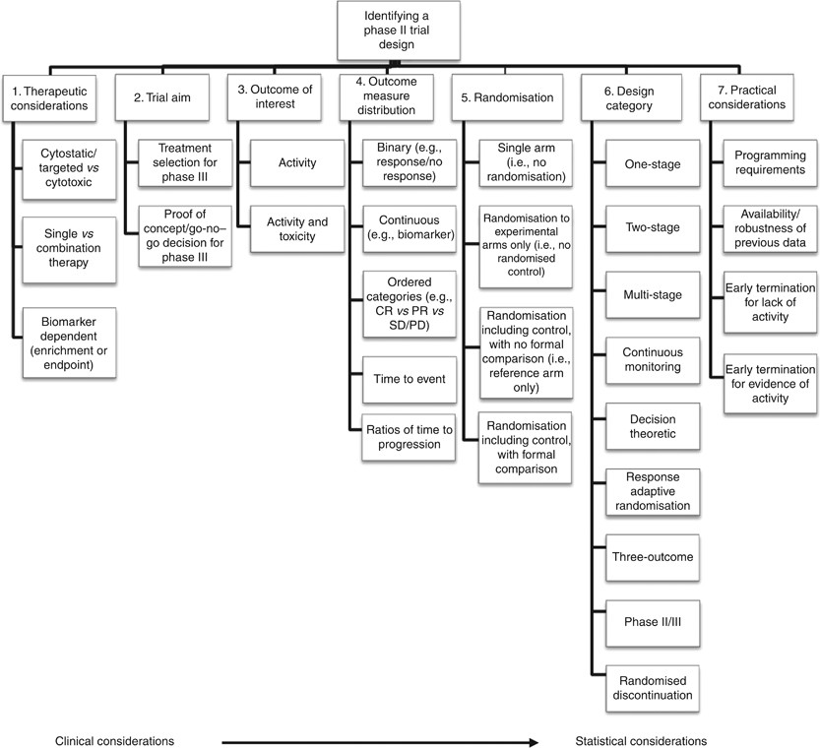

Slide 9
Preventing Failure: What Are Pilot Studies?
A small-scale test of the methods and procedures to be used on a larger scale
Not used to test hypotheses about the effects of an intervention, but rather, to assess the feasibility/acceptability of an approach to be used in a larger scale study.
Should not be used for safety assessments either

Slide 10
Disambiguation
Terms
Proof-of-Concept (PoC) study | Clinical trial carried out to determine if a treatment is biologically active or inactive
Adaptive Trial Design with Pilot | Design that allows modifications to be made to a trial's design or statistical procedures during its conduct with “piloting rules”
Notes:
The adaptations can be prospective (e.g. stopping a trial early due to safety or futility or efficacy at interim analysis); concurrent (e.g. changes in eligibility criteria, hypotheses or study endpoints) or retrospective (e.g. changes to statistical analysis plan prior to locking database or revealing treatment codes to trial investigators or patients).
“Piloting” is normally built into adaptive trial designs by determining a priori decision rules to guide the adaptations based on cumulative data.

Slide 11
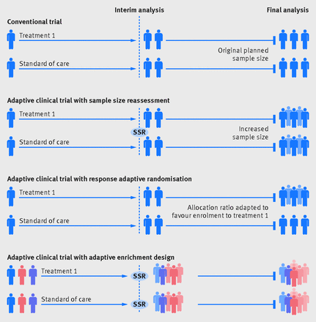
Notes:
Making adaptations too early can be problematic because small datasets are more prone to random error.
If sample size is small, irrespective of when interim analysis is done, reliable data on treatment magnitude is very limited.

Slide 12
Feasibility in Pilot Studies
Feasibility Questions | Feasibility Measures
Can I recruit my target population? | Number screened per month; number enrolled per month; average time delay from screening to enrollment; average time to enroll enough participants to form classes (group-based interventions)
Can I randomize my target population? | Proportion of eligible screens who enroll; proportion of enrolled who attend at least one session
Can I keep participants in the study? | Treatment-specific retention rates for study measures; reasons for dropouts
Will participants do what they are asked to do? | Treatment-specific adherence rates to study protocol (in-person session attendance, homework, home sessions, etc.); treatment-specific competence measures
Can the treatment(s) be delivered per protocol? | Treatment-specific fidelity rates
Are the assessments too burdensome? | Proportion of planned assessments that are completed; duration of assessment visits; reasons for dropouts
Are the treatment conditions acceptable to participants? | Acceptability ratings; qualitative assessments; reasons for dropouts; treatment-specific preference ratings (pre- and postintervention)
Are the treatment conditions credible? | Treatment-specific expectation of benefit ratings

Slide 13
Pitfalls of Estimating Efficacy using Pilot Studies

Slide 14
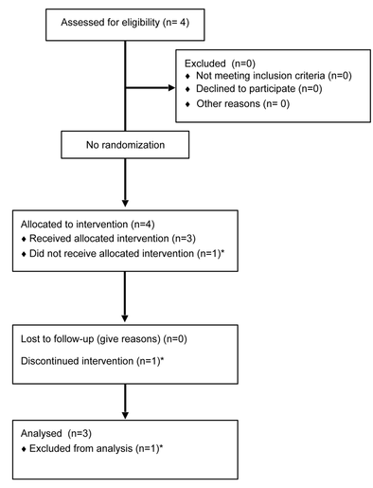
The Classical Single Arm Phase II
The classical design for a Phase II trial is single-arm.
A sample of individuals with the targeted medical condition is given the same experimental therapy and then followed over time to observe their response.
Helpful design when patient pool is limited, natural history of the disease is well understood, placebo not ethical
This is still heavily used in ID and oncology trials.

Slide 15
The Classical Single Arm Phase II
Rarely used to determine efficacy, but rather identify an efficacy signal while continuing to evaluate safety.

Slide 16
The Classical Single Arm Phase II
The Fleming 2-Stage Design
Only for single arm studies
Allows you to divide the trial into 2 stages and terminate early for futility or strongly positive result in the first stage.
What You Need to Define:
Type I error rate (𝛼)
Power
Response probability of poor drug, p0
Response probability of good drug, p1
When you provide these numbers, the calculation will give you
the number of patients that require enrollment,
the number of patients to be enrolled in stage 1 for the interim analysis
the probability of success or failure at the time of the interim analysis based on outcomes

Slide 17
The Classical Single Arm Phase II
Example: Cholesterol Agent
What You Need to Define: Example
Type I error rate (𝛼) – 0.05 (5%)
Power – 0.8 (80%)
Response probability of poor drug, p0 – 0.05 (5%)
Response probability of good drug, p1 – 0.15 (15%)
How Does the Calculation Use These Numbers? Example
The null hypothesis that the true response rate is [ p₀ ] when P₀ is <5% change in cholesterol using a novel agent.
In the first stage, [ n₁ = 25 ] patients will be accrued (out of anticipated N = 60). If there are [ a₁ = 1 ] or fewer responses in these [ n₁ ] patients, the study will be stopped for futility.
If there are [ b₁ = 4 ] or more responses in [ n₁ ] patients, the study will be stopped and the null hypothesis rejected.
Otherwise, [ n - n₁ = 60 – 25 = ] additional patients will be accrued for a total of [ n ].
This design yields a type I error rate of [ 0.05 ] and power of [ 0.8 ] when the true response rate is [ p₁ = 15% ]

Slide 18
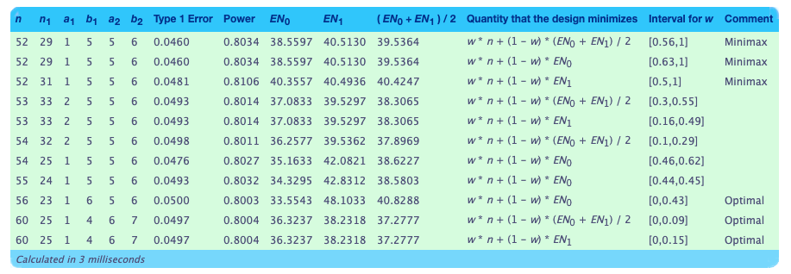
The Classical Single Arm Phase II
The Fleming 2-Stage Design

Slide 19
The Classical Single Arm Phase II
What Are the Limitations?
Inability to distinguish between the effect of the treatment, a placebo effect, and the effect of natural history.
Confounding due to effects of patient selection, trial eligibility, imaging techniques and assessment schedule, and treatment locations…

Slide 20
New Age Phase II: Trials with Historical Controls & Randomized Trials
Why change approach?
With advances in available medical therapies, the conclusions drawn from single arm studies have become significantly more limited due to added confounding and significant shift in natural history of most diseases under standard of care therapy.
The need to avoid expensive, large, futile, phase III trials.
Solutions?
Randomize subjects to two arms where placebo arm is control
May be difficult if enrollment is slow and disease is not very prevalent
Perform a single arm trial but compare results to historical controls
Rather than showing a change within the population studies
Notes:
Think tumor regression and survival, cholesterol levels and MI/survival…

Slide 21
Historical Controls
Using historical controls is more statistically and economically efficient.
It is important that these assumptions be met!
Expected outcomes for standard of care have not changed over time
Not only affected by new agents but also improvements in supportive care, earlier disease detection, differences in procedural performance, etc.
Inter-institution variability in outcomes is not significant
Most valid in procedural trials or for diseases that require advanced infrastructure for optimal management
Risk and prognosis of historical controls is similar to patients enrolled
If the risk profiles with regard to the outcome are different, the historical controls may underestimate or overestimate benefit

Slide 22
New Age Phase II: Why Randomized Trials?
Ability to eliminate several biases and not terminate testing of a potentially promising agent too early
Can allow for testing of multiple different regimens at the same time
Feasible if population of interest is large enough to allow for acceptable time frame for recruitment
Combined pilot study and proof-of-concept for Phase III trial

Slide 23
Selecting Patients for Phase II and Beyond
Subject Selection Design | Definition
All-comer Design | Screen all patients who have the disease of interest*
Enrichment Design | Can screen all patients, but only randomize certain patients who meet prespecified criteria based on level of biomarker, specific risk factors, or risk scores
Adaptive Design | If prespecified, may adjust enrichment parameters based on results of interim analysis
* Does not mean that inclusion/exclusion criteria are not present, but it means that inclusion and exclusion criteria are not meant to identify patients at higher risk to develop outcome

Slide 24
Designing a Phase II Trial: What Should We Consider
Trial Aim & Hypothesis
Outcome of Interest and Outcome Measure
Therapeutic Considerations
Patient Population
Comparator & Randomization
Trial Structure
Practical Considerations & Pilots
?
Notes:
Aim and Hypothesis – Safety, efficacy, both, dose finding….
Endpoints and how will you measure them? Time based?
What patients are the most likely to benefit from this agent? Is it feasible to recruit these patients? Will we need to enrich?
When will the drug be administered? How will it be administered? Background therapies?
Will this trial be single arm, randomized? If randomized, what will be your placebo?
Will the trial be single stage or multi-stage? If interim analyses are planned, at what point will they be done?
Things we don’t always think about – implementation – research structure, programming requirements, termination rules,
Prior data?
Available Capital

Slide 25
Take Home Messages
The main challenge for phase II trial design includes the need to identify drugs that are safe with sufficient activity for phase III testing.
Designs we historically single arm, but historical controls and randomized designs are gaining traction due to their advantages
A piloty study is not used to test hypotheses about the effects of an intervention, but to assess the feasibility of an approach to be used in a larger scale study.
Adaptive trial design allows for adjustment of modifications to be made to a trial's design or statistical procedures during its conduct
Notes:
Think tumor regression and survival, cholesterol levels and MI/survival…

