Slide 1
Power and Sample Size

Slide 2
Overview
Power and sample size estimations are used by researchers to determine how many patients are needed to answer the research question.
Clinical studies entail studying a sample of patients rather than the entire population. We then use this sample to draw inferences about the entire population.
The greater the proportion of the whole population studied, the closer we will get to true answer for that population.
But how many do we need to study in order to get as close as we need to the right answer?

Slide 3
What is Power
Power is the probability of rejecting the null hypothesis when the alternative hypothesis is true
Power is the probability of finding the difference when one truly exists.
Power is the probability of detecting the effect when the effect is there.
Power is the probability of avoiding type II error.

Slide 4
Type II error (β): the probability of not finding a statistically significant difference when the treatment is effective (false negative).
Power = 1-β

Slide 5
Type I error (α): The probability of rejecting the null hypothesis incorrectly (false positive).
Conventionally we choose a probability of <0.05 for a type I error. This means that if we find a positive result, the chances of finding this (or a greater difference) would occur on less than 5% of occasions.

Slide 6
Why is power conventionally set at ≥80%?
The FDA has required at least 80% power for controlled trials.
What does it mean to have a power of 80%?
If there is truly a treatment effect, the trial will be 80% likely to get a significant result.
There will be 20% chance of missing

Slide 7
What affects the power?
Sample size
Infinitely large study = infinitely certain of seeing a difference
Magnitude of a clinically significant difference
If we are looking for a big difference between treatments, we might be able to accept a wide probability distribution = small sample size
Variability in the population
Highly variable measurement = large sample size

Slide 8
What is sample size
Sample size is typically set so that the study has an adequate power to detect a clinically important treatment effect.
Sample size is too small: Not able to detect the existing treatment effect
Sample size is too large: Waste of time, money, resources; unnecessary exposure to a novel intervention

Slide 9
When to calculate sample size
Should be performed before the study
So that we can recruit enough patients to give our results with adequate power
Once the study is underway, analysis of the interim results may be used to perform further power calculations and adjustments made to the sample size accordingly.
Interim sample size calculations should only be used when stated a priori

Slide 10
Example: How to calculate sample size

Slide 11
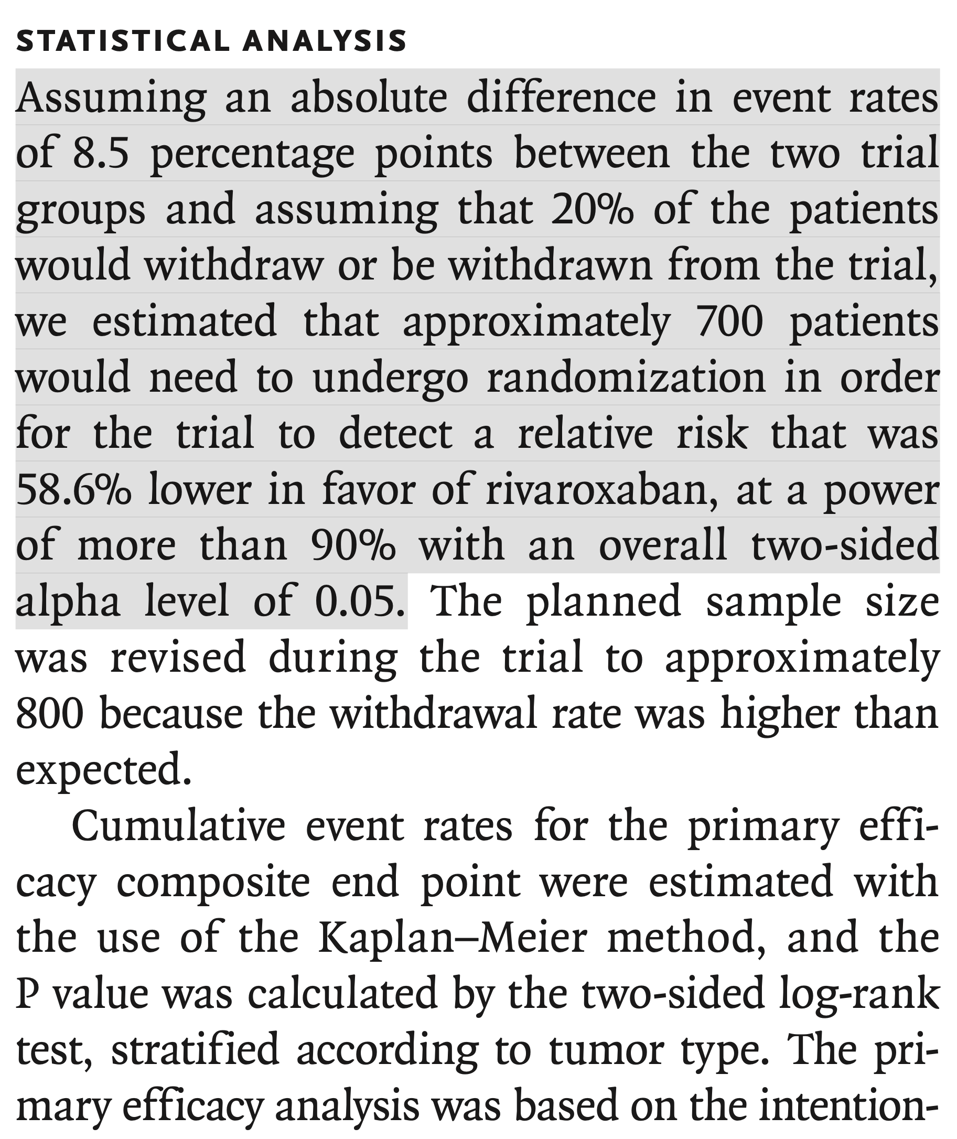

Slide 12
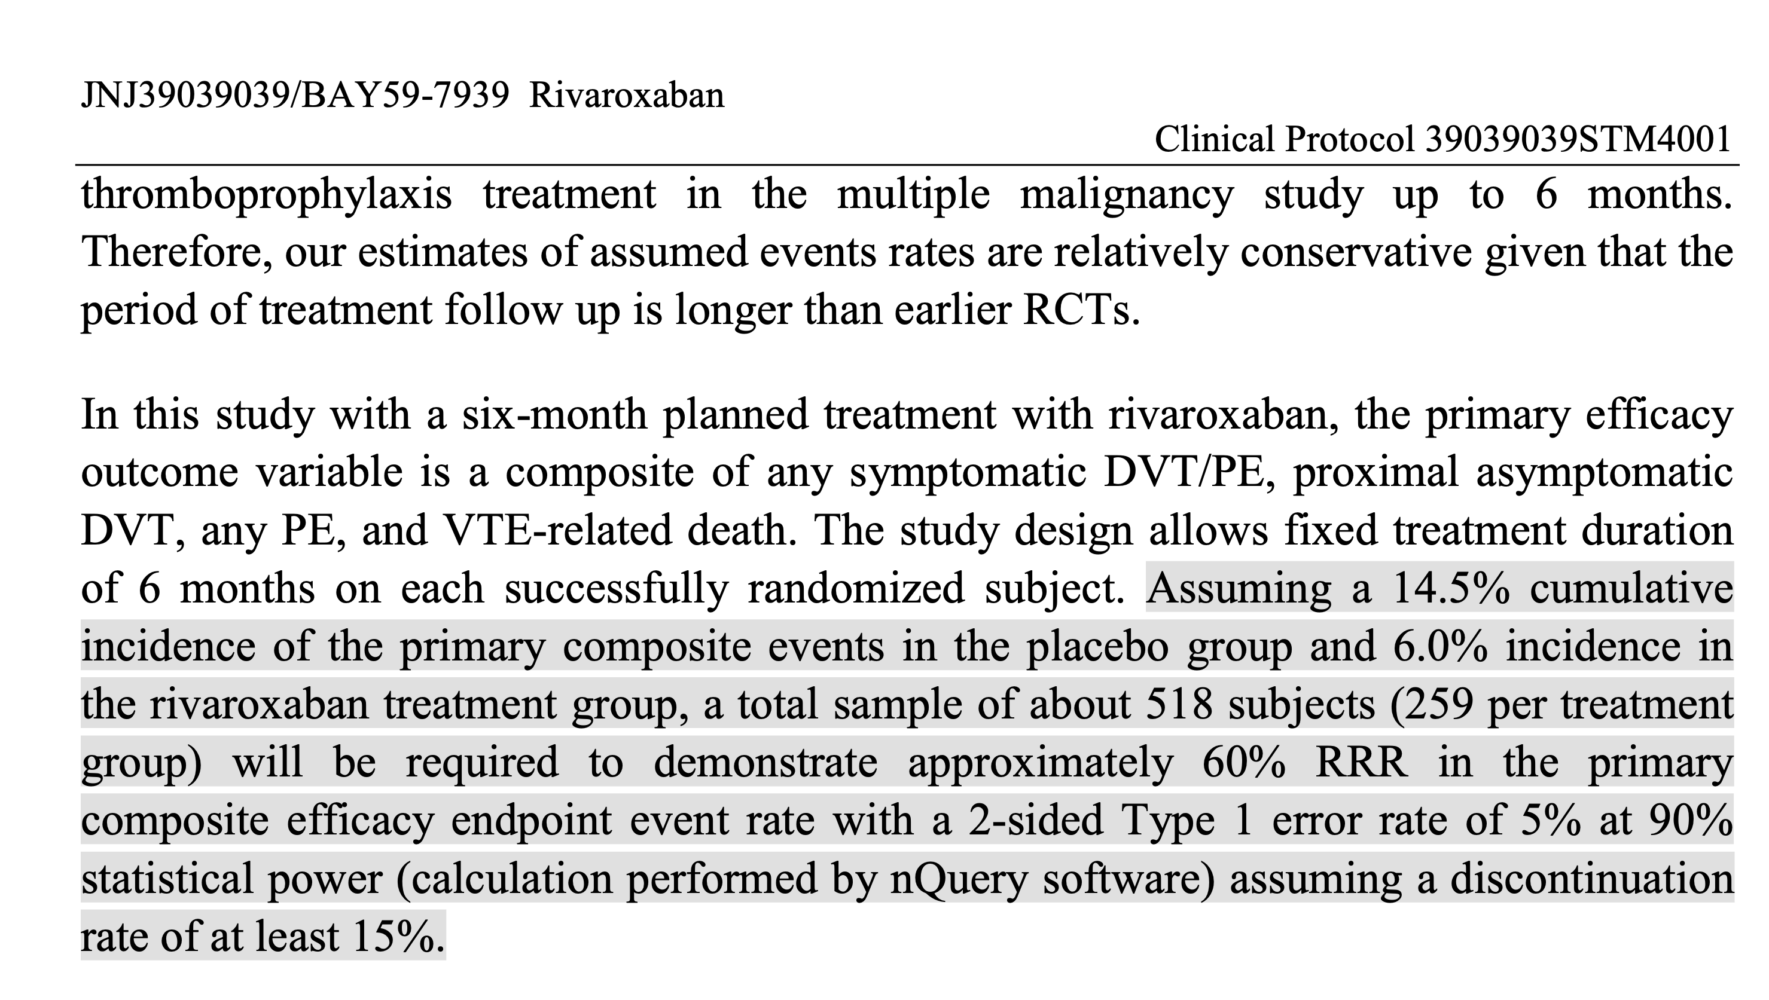

Slide 13
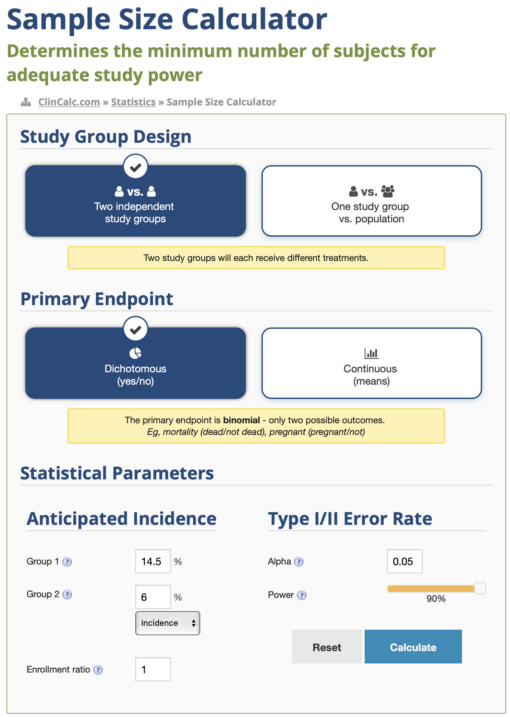

Slide 14
530/0.85 ≈ 624
530/0.80 ≈ 663

Slide 15
Summary
Power and sample size estimations are used by researchers to determine how many patients are needed to answer the research question.
Power is the probability of rejecting the null hypothesis when the alternative hypothesis is true (i.e., finding the difference when one truly exists).
Sample size calculation should be determined a priori.

Slide 16
Suggested reading
Jones S, Carley S, Harrison M. An introduction to power and sample size estimation. Emergency medicine journal: EMJ. 2003 Sep;20(5):453
NEJM Resident 360: Statistical Review – Power with Dr. David Harrington (https://resident360.nejm.org/curbside-consults/statistical-review-power-with-dr-dave-harrington)

