Slide 1
Measures of Association:
Odds Ratio vs. Relative Risk

Slide 2
Basic Terms: Probability
Probability is the proportion (i.e., percentage) of times an event would occur if an observation were repeated many times.
Probabilities range from 0.0 to 1.0.
For example, the weather forecast on a typical day might call for a probability of rain of 10%, or 0.10.

Slide 3
Basic Terms: Odds
Odds are the probability of an event divided by the probability of the event not happening. Thus, the odds of an event would be: Probability / (1– Probability)
Odds range from zero to infinity.
For example, if the probability of rain in a typical day is 0.10, the odds of rain today would be 0.10/(1– 0.10) or 0.10/0.90 = 0.11.

Slide 4
Basic Terms: Odds
When the chance of rain is low (typical day), the probability (0.10) and odds (0.11) of rain are similar, and one could reasonably use these terms interchangeably.
But if the weather forecast calls for a 90% probability of rain (ie, 0.90). The odds of rain would be 0.90/(1– 0.90) or 0.90/0.10 = 9.0.
With the storm approaching, the odds of rain are 9/1 (nine chances “yes” to one chance “no”).
The probability of rain is 0.90, while the odds of rain are 9.0, a tenfold difference.

Slide 5
Basic Terms: Relative Risk
Relative risk (aka risk ratio) is the ratio of probabilities.
For example, in a cohort study, the relative risk would be the probability of the outcome in those exposed divided by the probability of the outcome in those not exposed.
Because this expression is also a ratio, its values range from zero to infinity.

Slide 6
Basic Terms: Odds Ratio
Odds ratio is the ratio of odds.
An odds ratio is the odds of the outcome in one group divided by the odds of the outcome in the other group (analogous to relative risk).
Because this expression is also a ratio, its values range from zero to infinity.

Slide 7
Basic Terms: Odds Ratio
In the weather example above, the odds of rain with a storm approaching are 9.0, whereas the odds on an typical day are 0.11.
The odds ratio (OR) of rain with an approaching storm compared with a usual day is 9.0/0.11 = 82
The relative risk (RR) of rain is lower: probability with storm/probability on a typical day = 0.90/0.10 = 9.0.
Thus, the likelihood of rain with a storm approaching is nine times higher than on an average day (relative risk).

Slide 8
How to Calculate RR and OR?

Slide 9
Pitfalls of Odds Ratio
Unlike gamblers, clinicians think in probabilities.
For example, when randomly selecting a card from a deck, the probability of selecting a spade is 13/52 = 25%.
The odds of selecting a card with a spade are 25%/75% = 1:3.
Odds are useful when wagering because they represent fair payouts.
If one were to bet $1 on selecting a spade from a deck of cards, a payout of $3 is necessary to have an even chance of winning your money back.
From the gambler’s perspective, a payout smaller than $3 is unfavorable and greater than $3 is favorable.

Slide 10
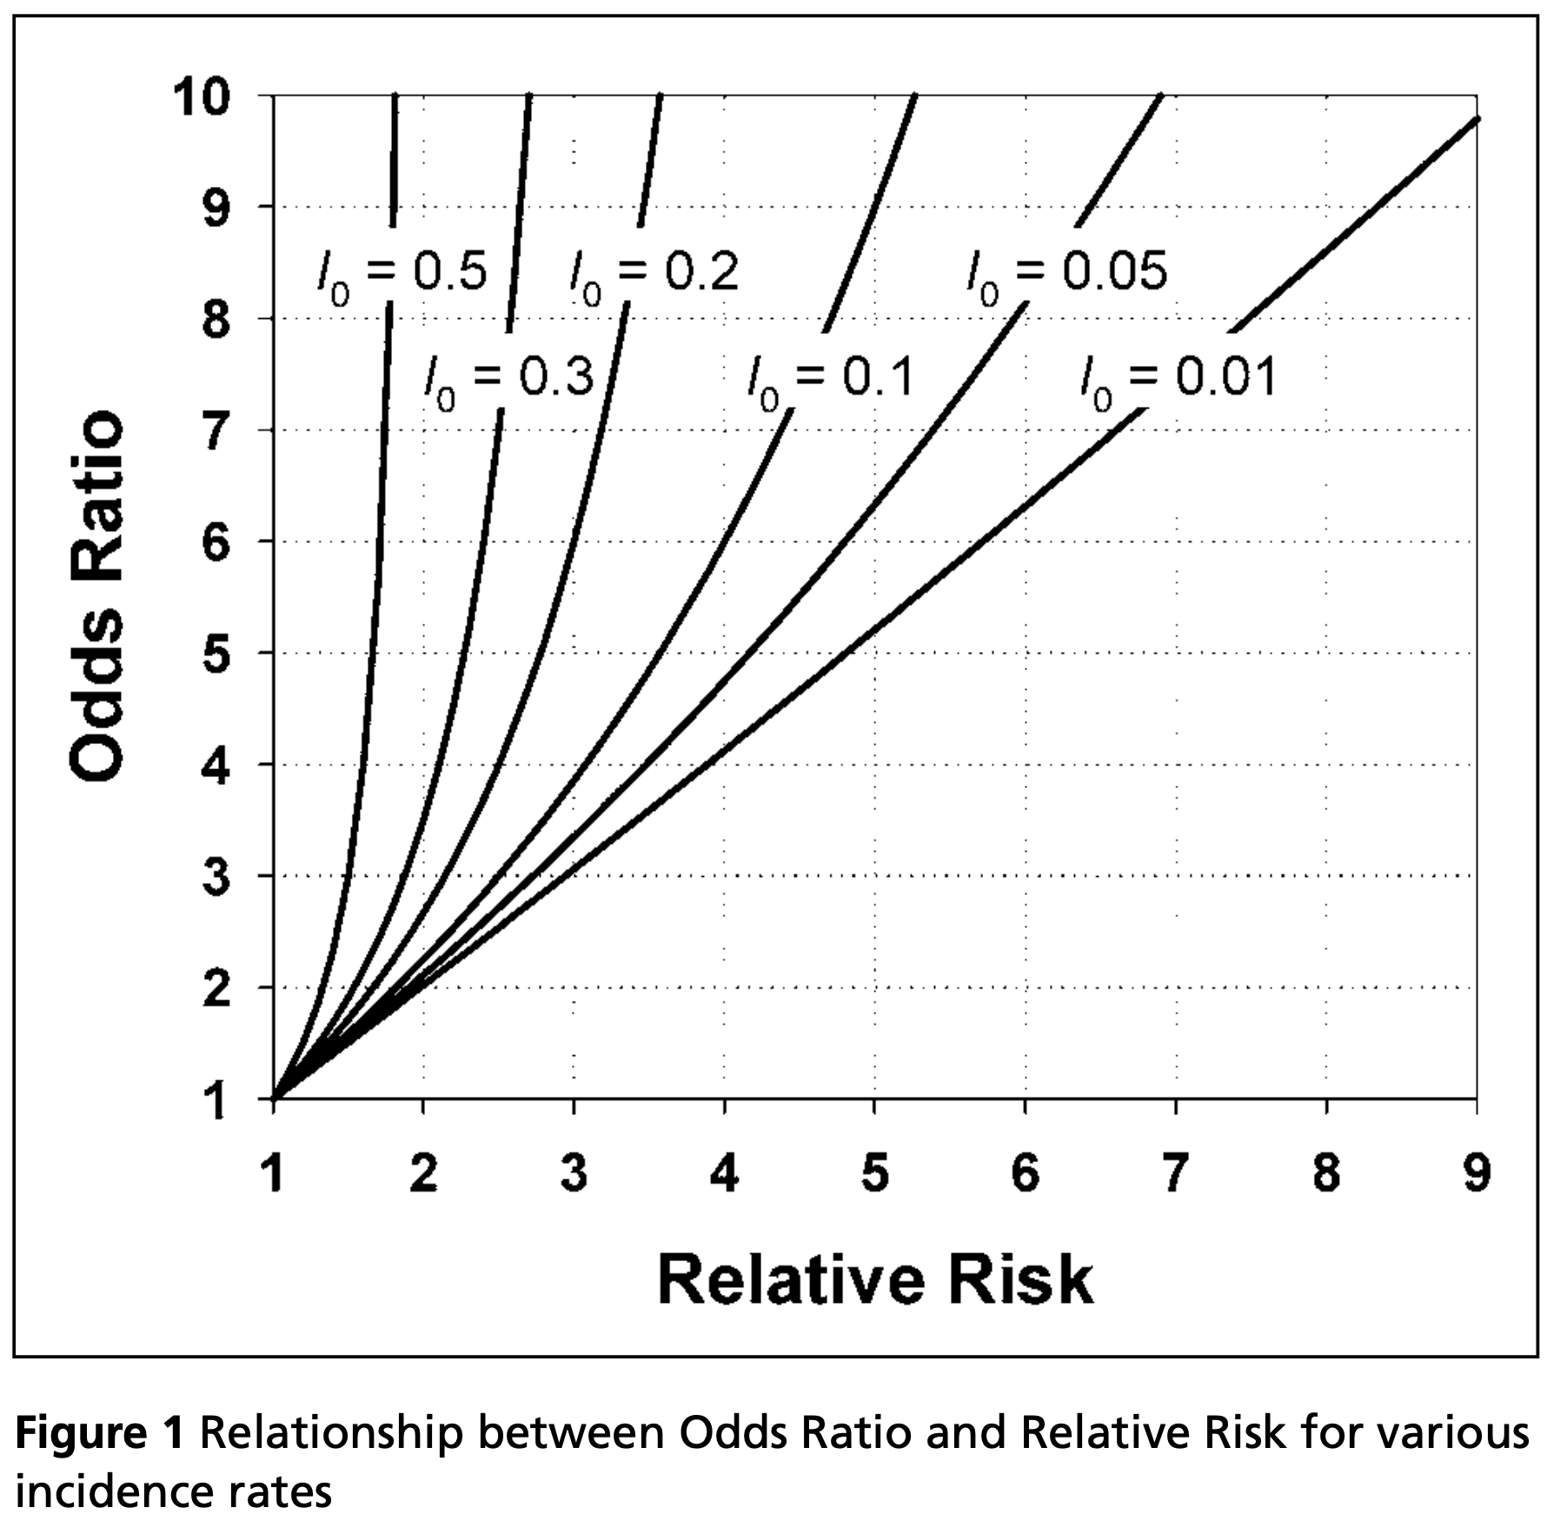
Pitfalls of Odds Ratio
Odds ratios exaggerate the effect size compared with a relative risk, especially for common outcomes.
This discrepancy becomes clinically important when the baseline probabilities of the outcome exceed 0.10 to 0.20.
Authors sometimes use the odds ratio as a proxy for the relative risk even when the disease is not rare, which is inappropriate and can lead to misinterpretation.

Slide 11
When to Report Odds Ratio?
Odds ratios are the appropriate measure of relative effect in case-control studies.
In case-control studies, researchers have a numerator (cases) but no denominator, so rates and relative risks cannot be determined.
Instead, investigators compare the frequency of exposure among cases with the frequency of exposure among the controls.

Slide 12
When to Report Odds Ratio?
Odds ratios are the output of logistic regression, a technique often used to control for confounding bias in analysis.
Odds ratios are commonly used in meta-analysis, which aggregates research studies to increase the power to find differences.

Slide 13
Summary
The relative risk and the odds ratio are the two most widely used measures of association in clinical research.
Odds ratios exaggerate the effect size compared with a relative risk, especially for common outcomes.
Odds ratios are the appropriate measure of relative effect in case-control studies.

Slide 14
Suggested Reading
Relative risks versus odds ratios. BMJ. 2014 Feb 7;348.
Odds ratios—current best practice and use. JAMA. 2018 Jul 3;320(1):84-5.
When to use the odds ratio or the relative risk?. International Journal of Public Health. 2008 Jun 1;53(3):165.

