Slide 1
Introduction to Observational Studies
Advantages and Disadvantages of Cohort Studies
PERFUSE Clinical Trial &
Medical Research Course
Clara Fitzgerald, MPH

Slide 2
Clinical Trial Design
Clinical Trials
Level of Evidence
 | 1= Strongest
 | 2
 | 3
 | 4
 | 5 = Weakest
Experimental
Observational
RCTs
Analytic
Descriptive
Cohort
Case Control
Cross-sectional
Case Series
Case Report

Slide 3
Study Designs for Clinical Research
Weakest evidence
Single case report (anecdote)
Consecutive case series
Retrospective case-control or cohort study
Prospective cohort with historical controls
Prospective cohort with contemporary controls
Single randomized clinical trial
Multiple large, randomized clinical trials
Strongest evidence

Slide 4
What do RCTs do well?
Provide for a controlled clinical experiment in which to assess for treatment effect
By definition, true randomization eliminates differences between groups due to bias except for the randomized exposure– any observed difference is necessarily by chance.
Validated statistical methods allow direct comparisons between groups to quantify differences between a specified control and the treatment group
Control group is contemporaneous

Slide 5
Potential RCT Flaws
Poor design
“Straw man” controls
Treatment effect assumptions (underpowered)
Non-inferiority trials with inappropriate delta or control
Lack of uniform endpoint definitions
Over-reliance on subgroup analyses
Poor execution
Protocol deviations
Crossovers/Withdrawals
Absence of blinding
Bias in endpoint assessment or adjudication

Slide 6
Limitations of RCTs
Timing of Evaluation
Too early in development
Inadequate data for selection of controls or estimate of treatment effect
Instability of the study treatment
Too late
Study treatment or potential control accepted as standard of care

Slide 7
Limitations of RCTs
Costs (including time factor)
Compromise in design or overly optimistic assumptions
Unreasonable treatment effects or event rates
Inappropriate composite endpoints
Increase Type 2 error (limit ability to detect small but possibly clinically significant differences)
Duration
Time from design to enrollment to results may outlast the viability of the question (evolution of standard of care)

Slide 8
Cohort Studies

Slide 9
What is a Cohort Study ?
Characteristics of Cohort Studies:
Defined group of subjects
Followed through time
Observed for outcome(s) of interest
Objective: to understand how the health status of cohort members change over time

Slide 10
Cohort Studies
Prospective Cohort Studies
Forward looking, also known as “Incidence Study, Longitudinal Study or Incidence Study”
Subjects are followed prospectively, with initial exposures and subsequent disease outcomes
Retrospective Cohort Studies
Backwards looking, also known as “Historical Cohort”
Subjects are identified from past records (such as medical or employment records) and followed from past to present to ascertained outcome data

Slide 11
Cohort Study Framework
Diseased
Exposed
Non-Diseased
Cohort Population
Diseased
Unexposed
Non-Diseased

Slide 12
Cohort Study Framework
Study time
Diseased
Lung Cancer
Exposed
Smokers
Non-Diseased
No Lung Cancer
Cohort Population
Diseased
Lung Cancer
Unexposed
Non-Smokers
Non-Diseased
No Lung Cancer

Slide 13
Steps of Cohort Study
Select study population
Obtain data on exposure
Select comparison group
Follow Up
Analysis

Slide 14
Selecting Study Populating
Types of Cohorts
Occupational (i.e. Asbestos workers, Nurses Health Study)
Convenience (i.e. College students, Graduating Class)
Insurance Plans
Community (i.e. Framingham)
Disease or Procedure
Natural History (i.e. Syncope)
Outcomes Research (i.e. Dialysis)

Slide 15
Data Collection
Clinic Visits
Physical Examination
Interviews
Laboratory Assays
Personal interviews
Mailed questionnaires
Medical records
Administrative Data
Birth or Death Records

Slide 16
Comparison Group & Study Follow Up
Comparison Groups
Internal Comparison
External Comparison
Study Follow up
Depends on-
Outcome of interest
Resources

Slide 17
Cohort Data Analysis
Incidence = New Cases
Temporality established
The central methods for comparing the frequency of disease:
Calculate a ratio of the two measures of disease frequency
Calculate the difference between the two measures by subtraction.
Key outcome measures:
Cumulative incidence (incidence proportion)
Cumulative incidence ratio (Relative Risk)
Cumulative incidence difference
Incidence density (Incidence rate)
Incidence density ratio
Incidence density difference
Notes:
Risk Ratio
Rate Ratio

Slide 18
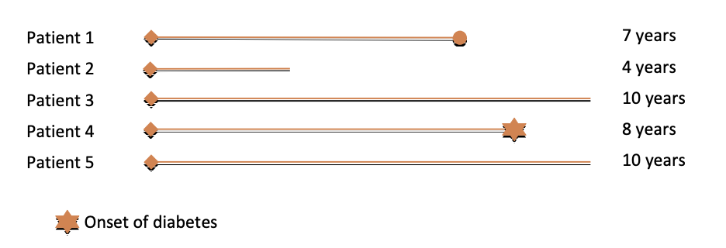
Incidence Proportion vs. Incidence Density
Incidence proportion = 1/5 = 0.2 or 20%
Incidence rate = 1 / (7+4+10+8+10) person-years,
= 1/39 PY
= 25.6 per 1000 PY
Notes:
Incidence proportion = number of new cases / number of population at risk at beginning of follow up
Incidence rate= number of new cases / summed person years of obervation

Slide 19
Comparison of Incidence
Incidence risk ratio - ratio of the two incidence proportions
= Incidence proportion in exposed
Incidence proportion in unexposed
Incidence rate ratio - ratio of the two incidence rates
= Incidence rate in exposed
Incidence rate in unexposed

Slide 20
Cohort Study Example: Framingham Heart Study
Started in 1948 to study the relationship of various factors on cardiovascular disease outcomes
Town of Framingham,
5,209 individuals (30 to 59 years old) enrolled
Subjects examined every 2 years for 20 years
What we have learned:
Hypertension, tobacco smoking and elevated blood cholesterol are associated with CHD
Increased physical activity associated with a decreased risk of CHD

Slide 21
Why would you do a cohort study? Advantages
Establish temporal sequence (exposure precedes outcome)
Incident cases
Study a range of possible risk factors
Several possible outcomes can be studied simultaneously
Hypothesis testing
Provide stronger evidence to support or refute a possible causal effect than cross sectional studies
Evidence to support RCT

Slide 22
Disadvantages of Cohort Studies
Requires large cohort of patients
Not suitable for rare diseases
Time
Cost
Concern about residual confounding
Drop out, death and other loss to follow up
Still subject to bias
Confounding
Selection bias
Information bias / misclassification

Slide 23
RCTs and Observational Studies Synergy of Strengths
Observational studies may improve efficiency of subsequent RCTs
Identify expected event rates and estimate treatment effects (sample size)
Identify appropriate endpoints to be tested
Identify subgroups likely (or not likely) to benefit
Observational studies may be used to expand generalizability of RCTs
Post market safety studies to assess low frequency events

Slide 24
References & Additional Reading
https://www.wikidoc.org/index.php/Observational_study
https://www.wikidoc.org/index.php/Longitudinal_study
Methodology Series Module 1: Cohort Studies; https://www.ncbi.nlm.nih.gov/pmc/articles/PMC4763690/

