Slide 1
Simple Regression: An Overview, and Simple Linear Regression
Arzu Kalayci, MD

Slide 2
Introduction
Regression analysis is a reliable method identifying which explanatory variables have an impact on a response variable.
Multiple regression models can obtain adjusted effect estimates that take the effect of potential confounders into account.
Regression modeling is a universal tool for data analysis in epidemiology.
The most important methods are linear regression for continuous outcomes, logistic regression for binary outcomes, Cox regression for time-to-event data, and Poisson regression for frequencies and rates.

Slide 3
Basic Structure of a Simple Regression Model
The basic structure of simple regression models is a linear equation:
(Some function of an outcome) = intercept + (slope)*(x₁), i.e.,
𝑓(𝑦) = 𝛽𝑜 + 𝛽₁𝑥₁
Where x₁ is a predictor of interest
(We’ll also see situations where a single predictor may need to be represented with more than a single x)
“Simple” refers to analyses with one predictor
We will also consider multiple regression, where there can be more than one predictor in a single model

Slide 4
Basic Structure: The Left-Hand Side -1
The left-hand side (𝑓(𝑦)) depends on what variable type the outcome of interest (𝑦) is:
For continuous outcomes, the left-hand side is the mean of the outcome 𝑦, ȳ, and the regression type is linear regression
For binary outcomes, the left-hand side is the 𝑙n(odds) of the binary outcome, i.e.: ln($\frac{p}{1−p}$), where p is the probability that y = 1 (proportion of y values equal to 1)
And the regression type is logistic regression

Slide 5
Basic Structure: The Left-Hand Side - 2
The left-hand side (𝑓(𝑦)) depends on what variable type the outcome of interest (𝑦) is:
For time-to-event outcomes where the individual event and censoring times are not known, y is yes/no indicator of whether the event occurred in the common follow-up period; the left-hand side is 𝑙n(incidence rate), and the regression type is Poisson regression
For time-to-event outcomes where the individual event and censoring times are known, y is a composite outcome taking into account both the time and whether the event occurred; the left-hand side is 𝑙n(hazard rate), and the regression type is Cox regression

Slide 6
Basic Structure: The Right-Hand Side
The right-hand side, 𝛽_{𝑜} + 𝛽₁𝑥₁, includes the predictor of interest, “𝑥₁ ”
This predictor of interest can be continuous, binary, or categorical (in which case, it will be represented by more than one 𝑥)

Slide 7
Interpretations of Results When Predictor Is Binary
Suppose 𝑥₁ is a binary predictor, such as sex (1 = female, 0 = male)
The resulting regression model is LHS = 𝛽𝑜 + 𝛽₁𝑥₁, where LHS = “left-hand side”
There are only two possible values 𝑥₁: 1 (female), 0 (male)
When 𝑥₁ = 1: LHS = 𝛽_{𝑜} + 𝛽₁(1) = 𝛽_{𝑜} + 𝛽₁
When 𝑥₁ = 0: LHS = 𝛽_{𝑜} + 𝛽₁(0) = 𝛽_{𝑜}
Interpretations:
𝛽_{𝑜} = value of LHS when 𝑥₁ = 0 (i.e., for males)
𝛽₁= difference in value of LHS for 𝑥₁ = 1, compared to 𝑥₁ = 0 (i.e, for females compared to males)

Slide 8
Interpretations of Results When Predictor Is Nominal -1
How to code 𝑥 when the predictor of interest is a nominal category, for example, clinic site (Hopkins, U of Maryland, U of Michigan)
For handling multiple nominal categories, the approach is to designate one of the groups as the “reference category” and create binary 𝑥’s for each of the other groups
For example, if we make Hopkins the reference, we will need additional variables:
𝑥₁ = 1 if U of Maryland, 0 if not
𝑥₂ = 1 if U of Michigan, 0 if not

Slide 9
Interpretations of Results When Predictor Is Nominal - 2
The resulting model is LHS = 𝛽𝑜 + 𝛽₁x₁ + 𝛽₂x_{2,} where LHS = “left-hand side”
The result for each possible combination of x₁ and x₂ values:
When 𝑥₁ = 0, 𝑥₂ = 0: LHS = 𝛽_{𝑜} + 𝛽₁(0) = 𝛽_{𝑜}
When 𝑥₁ = 1, 𝑥₂ = 0: LHS = 𝛽_{𝑜} + 𝛽₁(1) + 𝛽₂(0) = 𝛽_{𝑜} + 𝛽₁
When 𝑥₁ = 0, 𝑥₂ = 1: LHS = 𝛽_{𝑜} + 𝛽₁(0) + 𝛽₂(1) = 𝛽_{𝑜} + 𝛽₂

Slide 10
Interpretations of Results When Predictor Is Continuous
This is an efficient approach to handling measurements that are made continuously (age, height, etc.) without arbitrarily having to categorize them (if the outcome/predictor association is well characterized by a line)
For example, suppose x1 is age in years, and the regression equation is LHS = 𝛽_{𝑜} + 𝛽₁x₁
How to interpret 𝛽_{𝑜} and 𝛽₁?

Slide 11
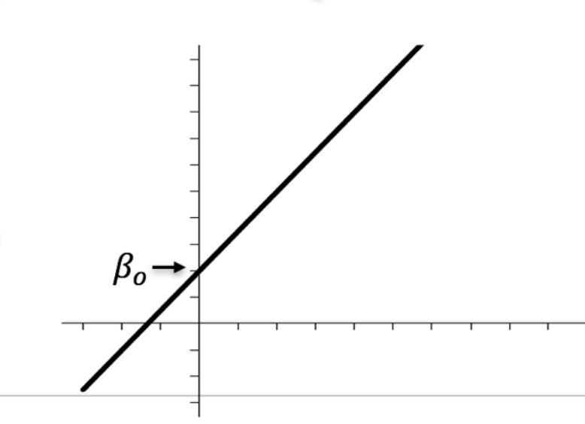
The Intercept
The intercept, 𝛽_{𝑜}, is the value of left-hand side (LHS) when x₁ = 0
It is the point on the graph where the line crosses the vertical (y) axis, at the coordinate (0, 𝛽_{𝑜})
y = b +mx

Slide 12
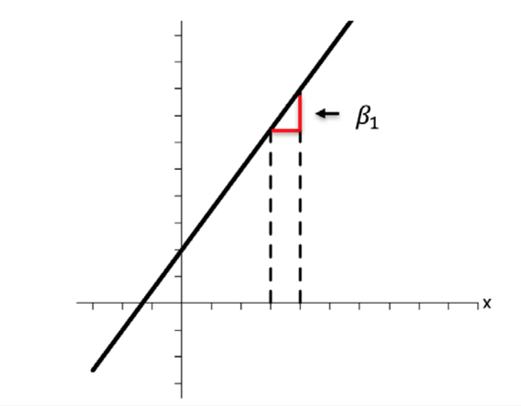
The Slope -1
The slope, 𝛽₁, is the change in the left-hand side, corresponding to a unit increase in x₁

Slide 13
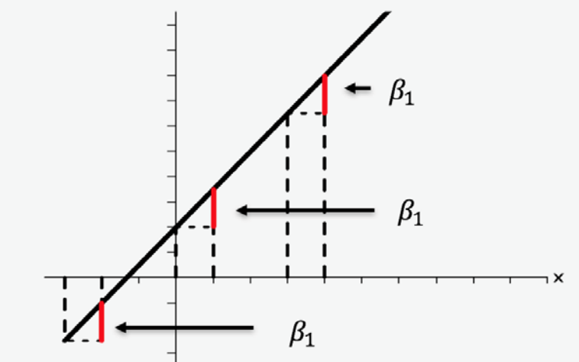
The Slope - 2
The slope, 𝛽₁, is the change in the left-hand side, corresponding to a unit increase in x₁: in other words, 𝛽₁ is difference in the left-hand side for x₁ +1, compared to x₁
This change/ difference is the same across the entire line

Slide 14
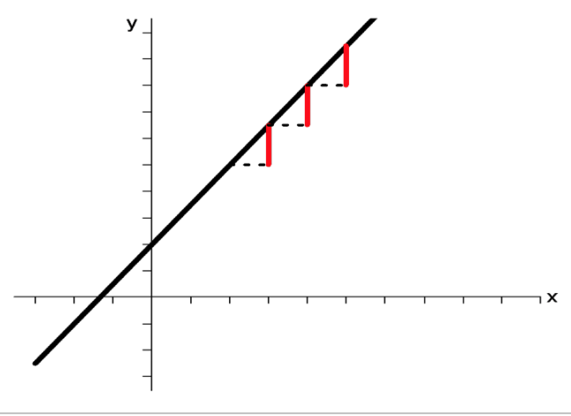
The Slope - 3
All information about the difference in the left-hand side for two differing values of x₁ is contained in the slope!
For example: two values of x₁ three units apart will have a difference in left-hand side values of 3 ∗ 𝛽₁

Slide 15
Summary
Regression is a general set of methods for relating a function of an outcome variable to a predictor via a linear equation of the form LHS = 𝛽_{𝑜} + 𝛽₁x₁, where LHS = “left-hand side”
Regardless of whether the predictor x₁ is binary, categorical, or continuous,
𝛽_{𝑜} is the value of the LHS when x₁ (or all x’s if predictor is multi-categorical) = 0
𝛽₁ is the change in the value of LHS for a one-unit difference in x1 (the difference in LHS for a one-unit difference in x1)

Slide 16
THANK YOU

