Slide 1
Cross-Sectional Study

Slide 2
Cross-sectional study: Overview
A cross-sectional study is a type of observational study design that involves looking at data from a population at one specific point in time.
In a cross-sectional study, investigators measure outcomes and exposures of the study subjects at the same time.
It is described as taking a “snapshot” of a group of individuals.

Slide 3
Cross-sectional study: Overview
The subjects in a cross-sectional study are chosen from an available population of potential relevance to the study question.
Unlike in case-control studies (subjects selected based on the outcome status) or cohort studies (subjects selected based on the exposure status)
There is no prospective or retrospective follow-up.
Once the subjects are selected, the investigators will collect the data and assess the associations between outcomes and exposures.

Slide 4
Cross-sectional study: Overview

Slide 5
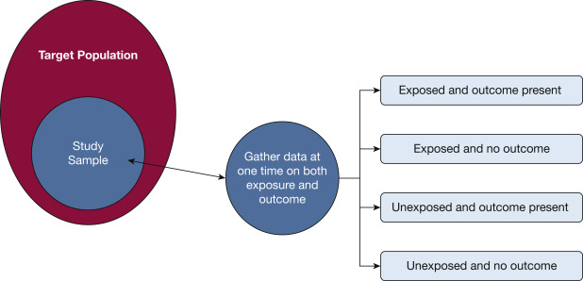
Cross-sectional study: Overview

Slide 6
Cross-sectional study: Strengths
Relatively quick and inexpensive to conduct
No ethical difficulties
Data on all variables are only collected at one time point
Multiple outcomes and exposures can be studied
Can estimate prevalence of outcome of interest because sample is usually taken from the whole population
No loss to follow-up
Easy for generating hypotheses

Slide 7
Cross-sectional study: Weaknesses
Unable to measure the incidence
Difficult to make a causal inference
Associations identified might be difficult to interpret
Unable to investigate the temporal relation between outcomes and risk factors
Not appropriate for studying rare diseases
Susceptible to biases such as nonresponse bias, recall bias, prevalence-incidence bias

Slide 8
Cross-sectional study: Sampling methods
Probability sampling methods, in which samples are chosen by using a method based on the theory of probability (Preferred)
Simple random sampling: Every member of the population has the same probability of being randomly selected into the sample
Systematic sampling: One selects every nth (ie, 10th) subject in the population to be in the sample
Stratified sampling: The population is divided into non-overlapping groups, or strata; a random sample of population members is then collected from within each stratum
Clustered sampling: The researcher divides the population into separate groups, called clusters. Then, a simple random sample of clusters is selected from the population. Note that the clusters are used as the sampling unit, rather than individuals

Slide 9
Cross-sectional study: Sampling methods
Non-Probability sampling methods, in which samples are chosen by using a method based on subjective judgment
Convenience sampling: Participants are selected based on availability and willingness to take part
Quota sampling: A tailored sample that is in proportion to some characteristic or trait of a population
Purposive sampling: Also known as judgmental or subjective sampling. It relies on the judgment of the researcher when choosing members of the population to participate in a study
Snowball sampling: Existing study subjects recruit future subjects from among their acquaintances

Slide 10
Cross-sectional study: Statistical considerations
Confounding
For a variable to be a confounder, it should meet three conditions. The variable must:
(1) be associated with the exposure being investigated
(2) be associated with the outcome being investigated
(3) not be in the causal pathway between exposure and outcome
Confounding could result in a distortion of the association between exposure and outcome.

Slide 11
Cross-sectional study: Statistical considerations
Controlling for confounding
Restriction: Investigators limit participation in the study to individuals who are similar with respect to the confounders.
Stratification: Refers to the study of the association between exposure and outcome within different strata of the confounding variables.
Propensity score matching: Forming matched sets of two groups of subjects who share a similar value of the propensity score.
Multivariable regression analysis: Based on the regression equation, the effect of the variable of interest can be examined with confounding variables that are held constant statistically.

Slide 12
Cross-sectional study: Reporting considerations
Strengthening the Reporting of Observational Studies in Epidemiology (STROBE) statement
Transparent Reporting of a Multivariable Prediction Model for Individual Prognosis or Diagnosis (TRIPOD) statement

Slide 13
Summary
A cross-sectional study is a type of observational study design that involves looking at data from a population at one specific point in time.
The purpose is to describe a sample within the population with respect to an outcome and a set of risk factors.
Confounding could result in a distortion of the association between exposure and outcome.

Slide 14
Suggested Reading
Wang X, Cheng Z. Cross-sectional studies: strengths, weaknesses, and recommendations. Chest. 2020 Jul 1;158(1):S65-71.
Sedgwick P. Cross sectional studies: advantages and disadvantages. Bmj. 2014 Mar 26;348.
Sedgwick P. Bias in observational study designs: cross sectional studies. Bmj. 2015 Mar 6;350.

