Slide 1
Clinical Trial Protocols
PERFUSE Clinical Trial Course
Clara Fitzgerald, MPH

Slide 2
Lecture Part | Topic | Presenter
Part 1 | Introduction: Principles of Protocol Design and Development | Clara
 | Protocol Overview: Protocol Elements / Table of Contents | Clara
 | Statistical Methods, Eligibility & Design | Clara
Part 2 | Subject Enrollment & Randomization | Arzu
 | Study Procedure & Intervention Details | Arzu
Part 3 | Data: Clinical Protocol Assessments & Data Collection | Gerry
 | Case Report Forms | Gerry
Part 4 | Clinical Protocol Amendments and Violations | Clara
 | Resources for Clinical Protocol Development | Clara

Slide 3
Goals of Clinical Study Protocols
What is a Clinical Study Protocol?
“A complete written description of, and scientific rationale for, research involving human subjects”
Objectives:
Road map for operationalizing study
Consistency of Data Collection
Facilitates communications among interdisciplinary team
Assist in manuscript authorship and preparation

Slide 4
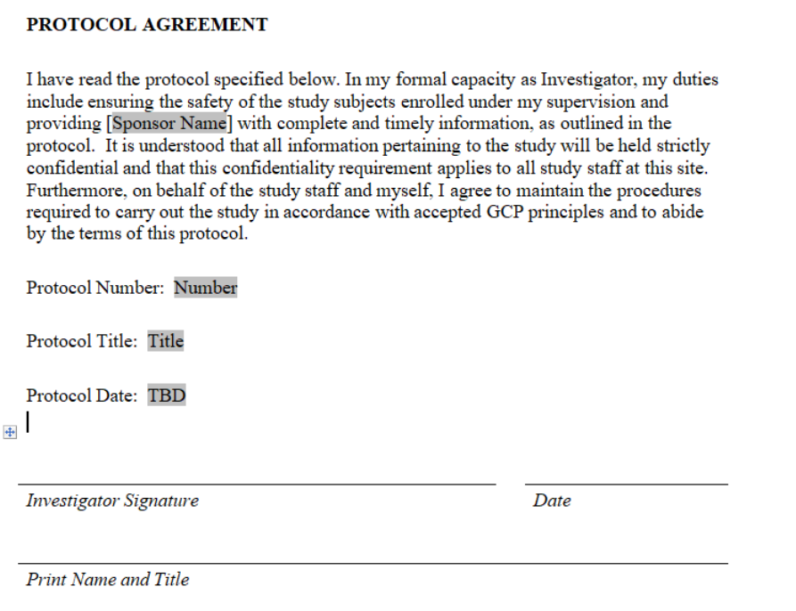
Protocol Establishes Mutual Understanding and Agreement
Notes:
this is borrowed from a Protocol template provided by https://hub.ucsf.edu/protocol-development

Slide 6
Interdisciplinary Team
Protocol development should include an interdisciplinary team:
Investigator
Sponsor
Statistician
Clinical Team
Study Staff

Slide 7
Clinical Trial Phases & Protocols
Goal & structure of the Protocol will mirror the objective of clinical trial phase
Phase 1 – Safety
Phase 2 – Efficacy & Safety
Phase 3 – Validation of Efficacy and Safety

Slide 8
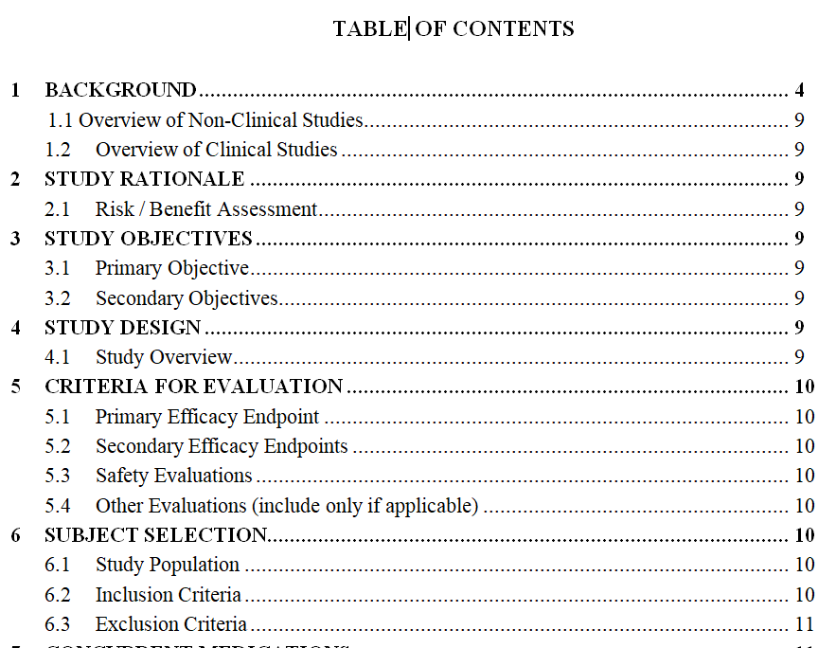
Key Protocol Elements – Table of Contents Template

Slide 9
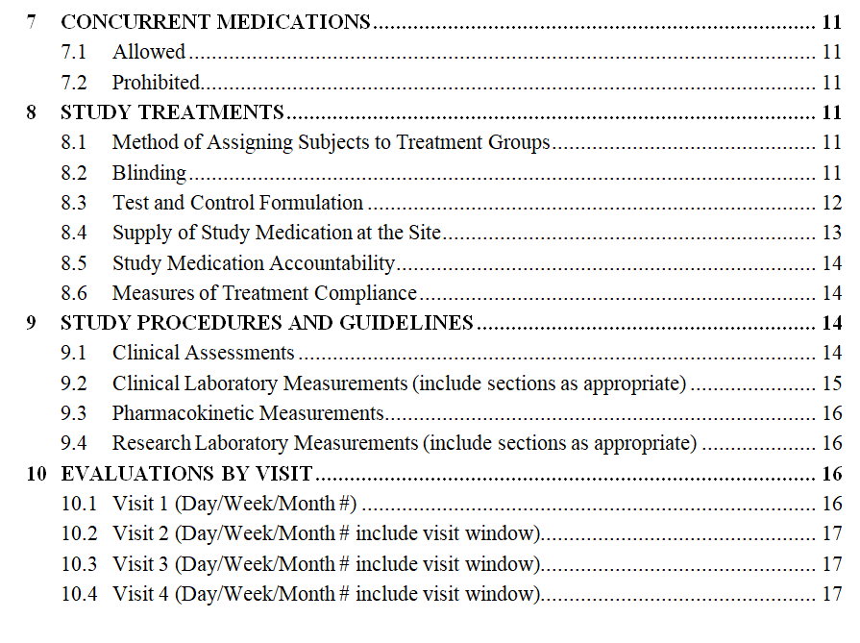
Protocol Table of Contents Template Cont.

Slide 10
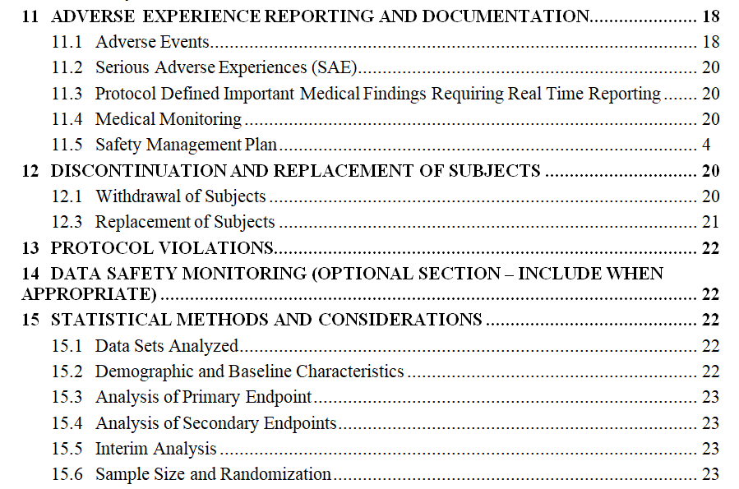
Protocol Table of Contents Template Cont.

Slide 11
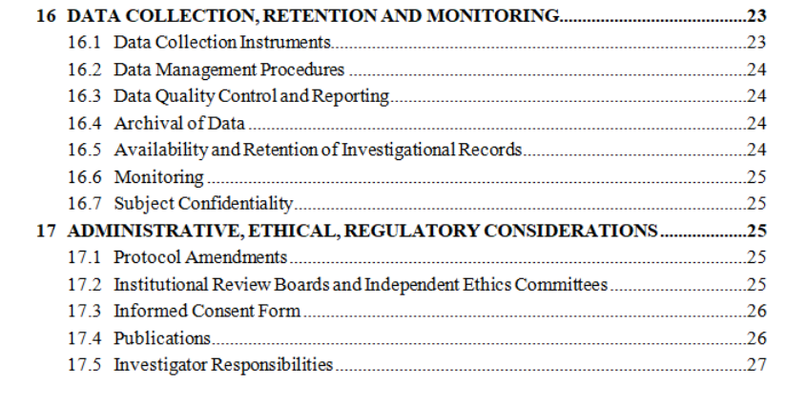
Protocol Table of Contents Template Cont.

Slide 12
Statistical Analysis Section
Statistical Methods & Considerations
Data Sets
Analysis of Primary Endpoint
Analysis of Secondary Endpoint
Interim Analysis
Sample Size and Power
Sample Size and Power Calculation may determine study feasibility
Ensure required number of subjects fits budget and timeline

Slide 13
Sample Size and Power Determination
Factors important in Sample Size Analysis
Significance level of the test (alpha)
Usually 0.05
Power
Usually between 0.8 and 0.9
80% probability that you will correctly reject null hypothesis
Estimated effect size
The difference of two group means divided by the pooled standard deviation
From previous studies
Sample size
Required number of patients
Important to consider:
Loss to follow up
Lack of compliance
Clinical significance vs. statistical significance

Slide 14
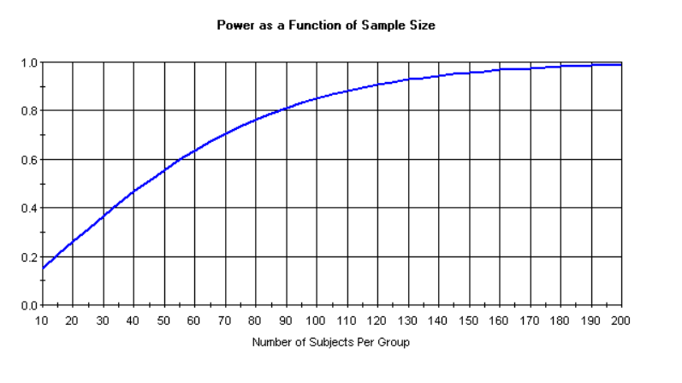
Power as a Function of Sample Size

Slide 15
Statistical Analysis Section
Statistical Methods & Considerations
Data Sets
Analysis of Primary Endpoint
Analysis of Secondary Endpoint
Interim Analysis
Sample Size and Randomization

Slide 16
Overview of Analysis Sets
 | Full Analysis Set | Per- Protocol | Safety
Patients Included: | Intent to Treat (ITT) Principle- every patient randomized enters the primary analysis | Patients that have completed satisfactory compliance with treatment (no major protocol violations or deviations) | “As treated” principle-Patients that received any study treatment, actual treatment received
Aim: | Provide estimates which are more likely to mirror real word clinical practice Avoid bias that may be caused by exclusion of patients | Aims to identify a treatment effect which would occur under optimal conditions i.e. all patients are compliant | To analyze safety, including adverse events, toxicity and laboratory evaluations
Referred to As: | Full analysis set (FAS) or “As randomized” | Per-protocol set (PPS), ‘efficacy’ sample or ‘evaluable subjects’ sample | Safety set
Used for: | All Efficacy Analyses | Sensitivity Analyses | Safety Analyses

Slide 17
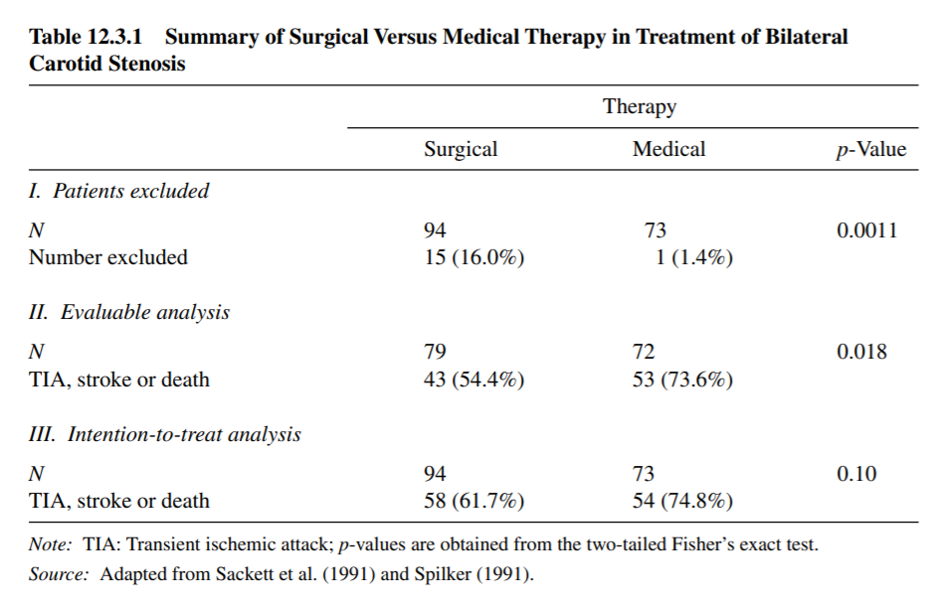
Application of Analysis Sets

Slide 18
Statistical Analysis Section
Statistical Methods & Considerations
Data Sets
Analysis of Primary Endpoint
Analysis of Secondary Endpoint
Interim Analysis
Sample Size and Randomization

Slide 19
Statistical Analysis Section
Statistical Methods & Considerations
Data Sets
Analysis of Primary Endpoint
Analysis of Secondary Endpoint
Interim Analysis
Sample Size and Randomization

Slide 20
Overview of Interim Analysis
Why perform Interim Analysis During a clinical trial?
Analyses for Safety, Efficacy, Futility or sample size re-estimation
Reduce subject exposure to inferior or harmful treatment
Ensure efficient use of resources
Who performs an Interim Analysis?
Data Safety Monitoring Board (DSMB) or Independent Data Monitoring Committee (IDMC)
In independent group of experts that reviews accumulating data at specified time points and advises the Steering Committee
What information is included in the Clinical Study Protocol for the Interim Analysis?
All details about the timing, frequency and methods should be specified in the trial protocol before the study begins

Slide 21
Questions?

