Slide 1
Coronary Anatomy
WikiDoc
C
Copyleft WikiDoc.org Attribution required

Slide 2
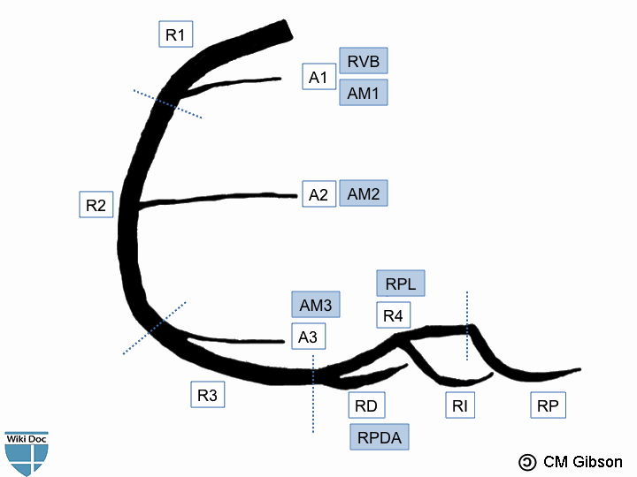
Right Coronary Artery

Slide 3
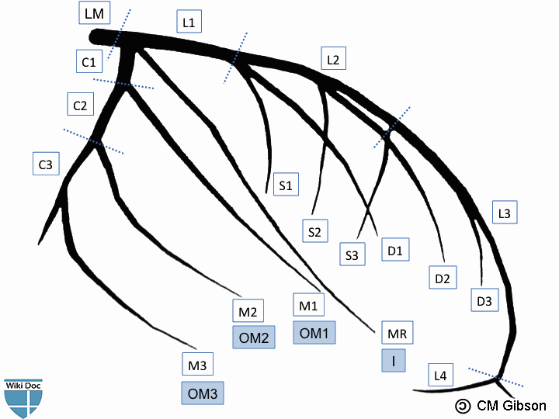
Left Coronary Artery

Slide 4
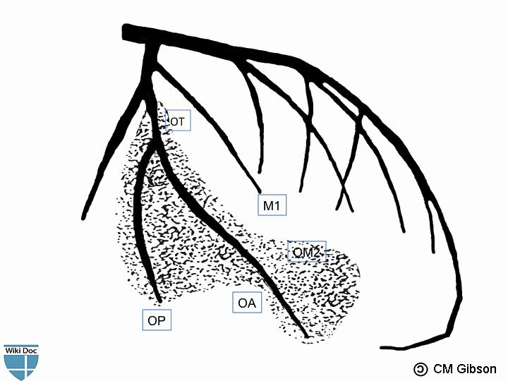
Left Coronary Artery

Slide 5
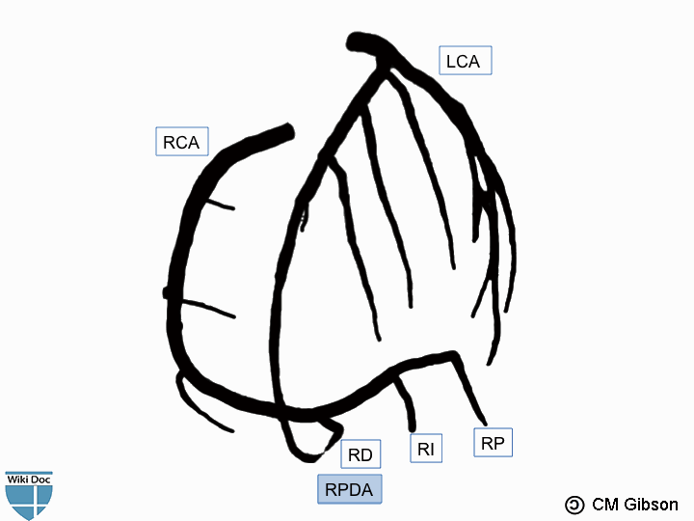
Large Right Dominance

Slide 6
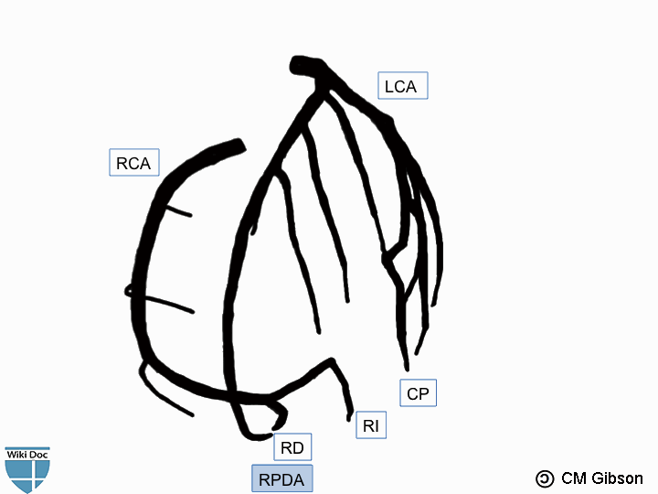
Small Right Dominance

Slide 7
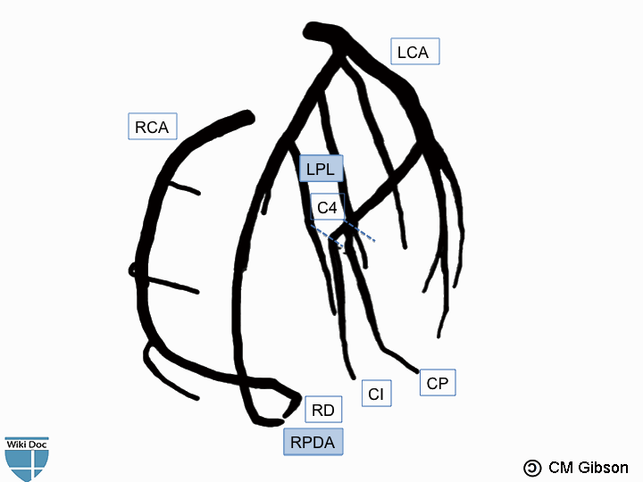
Co-Dominance

Slide 8
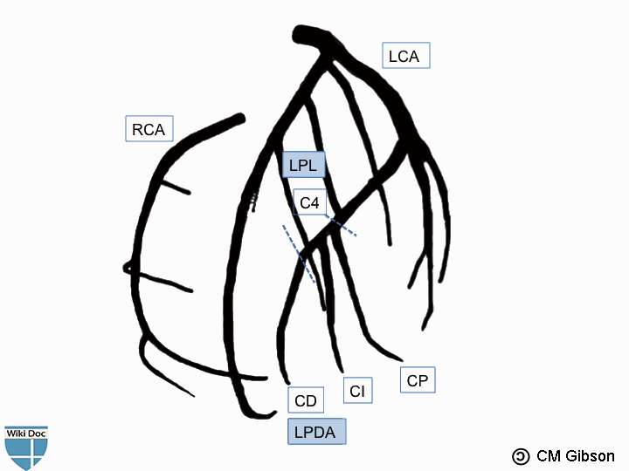
Left Dominance

